Slide 1
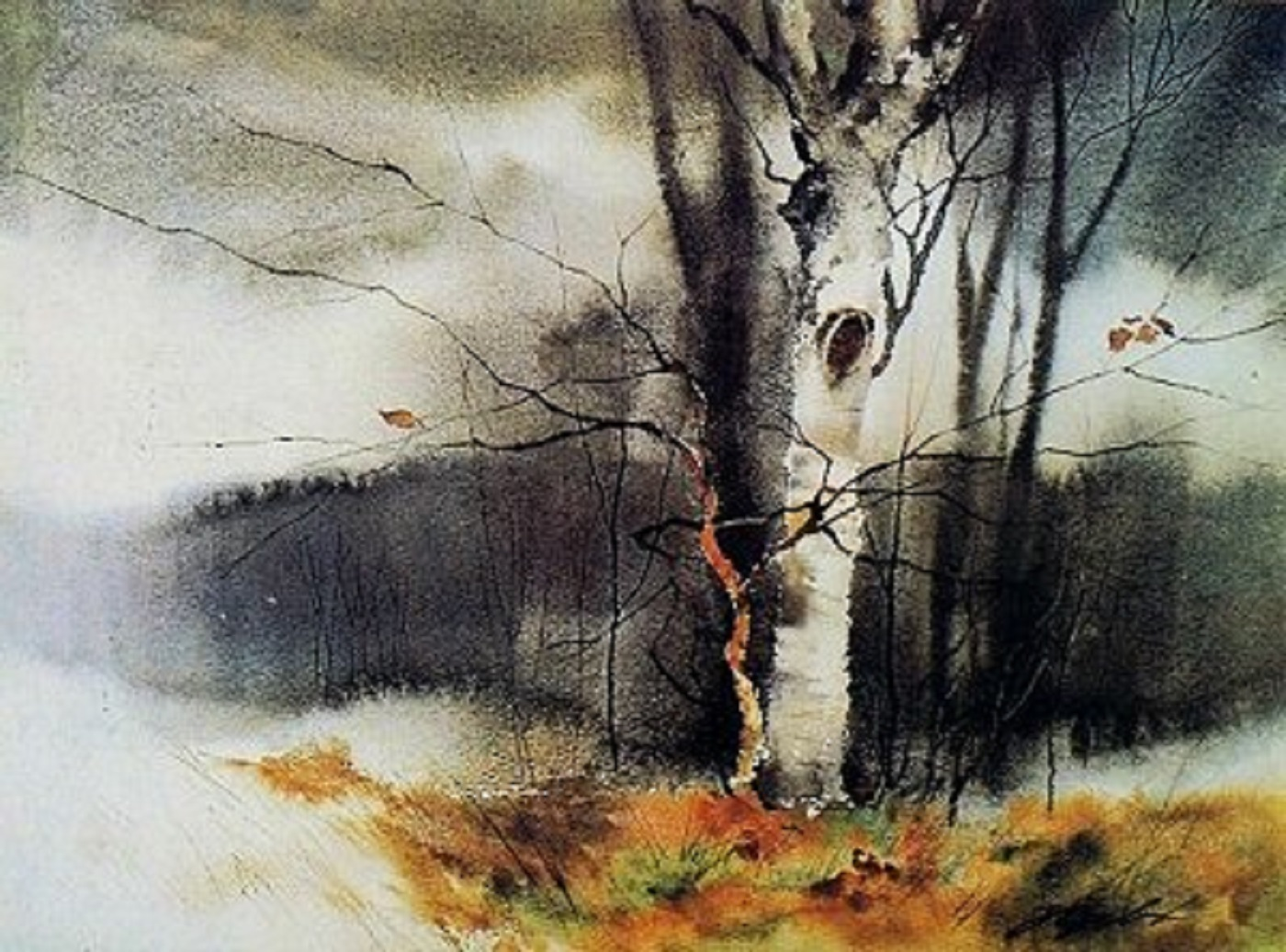
“Birch at Hart Lake”
- Zoltan Szabo

Slide 2
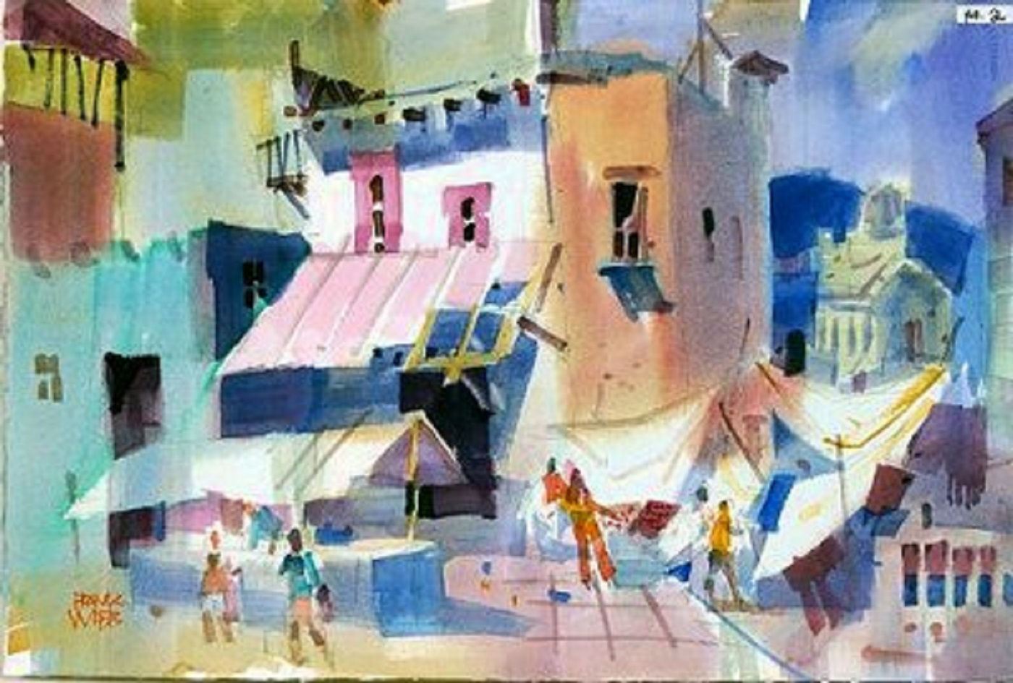
“San Miguel Allende”
- Frank Webb

Slide 3
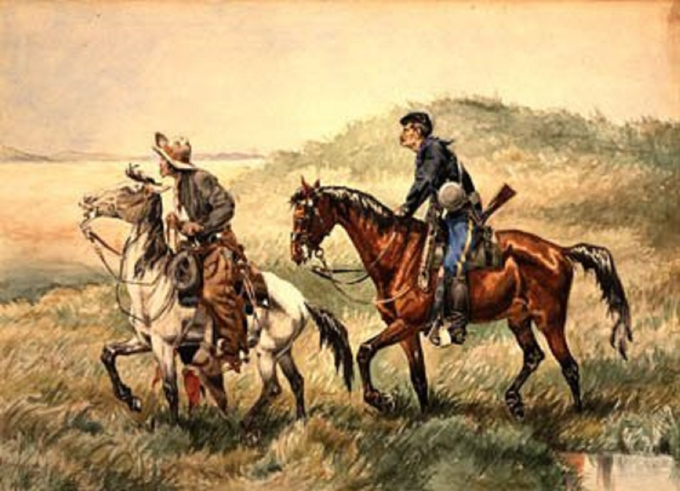
“The Couriers”
- Frederic Remington

Slide 4
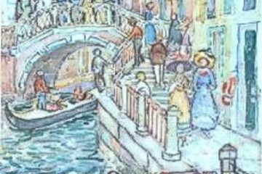
“Bridge and Steps, Venice”
- Maurice Brazil Prendergast

Slide 5
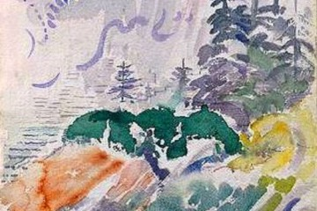
“Marin Island”
- John Marin

Slide 6
“Autumn Flight”
- Tom Lynch

Slide 7
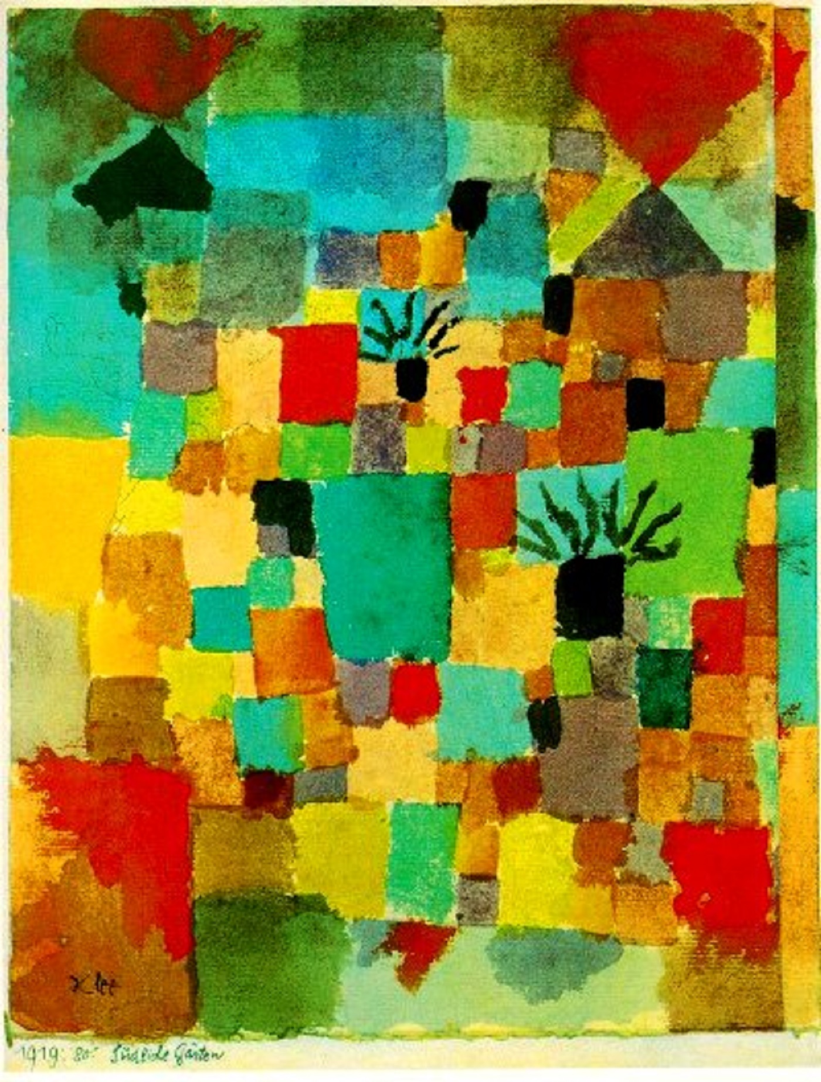
“Southern (Tunisian) Gardens”
- Paul Klee

Slide 8
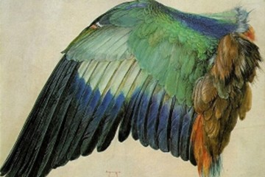
“Wing of a Roller”
- Albrecht Dürer

Slide 9
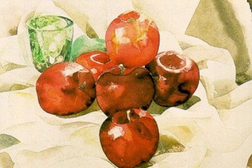
“Still Life with Apples and a Green Glass”
- Charles Demuth

Slide 10
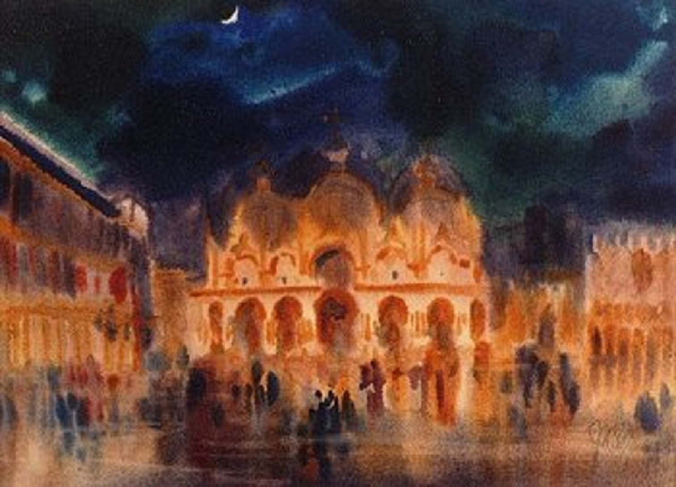
“Venice Evening”
- J.W.S. Cox

Slide 11
“Japanese Jewel”
- Sterling Edwards

Slide 12
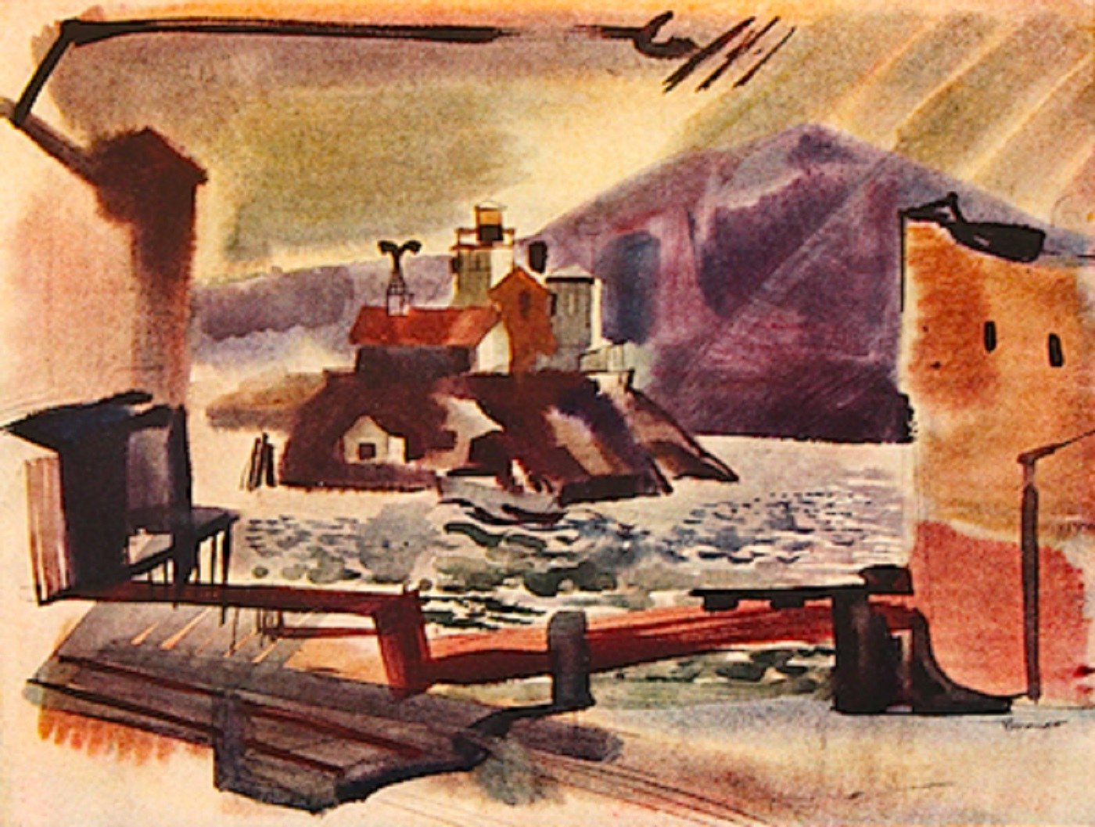
“The Brothers Light”
- Rex Brandt

Slide 13
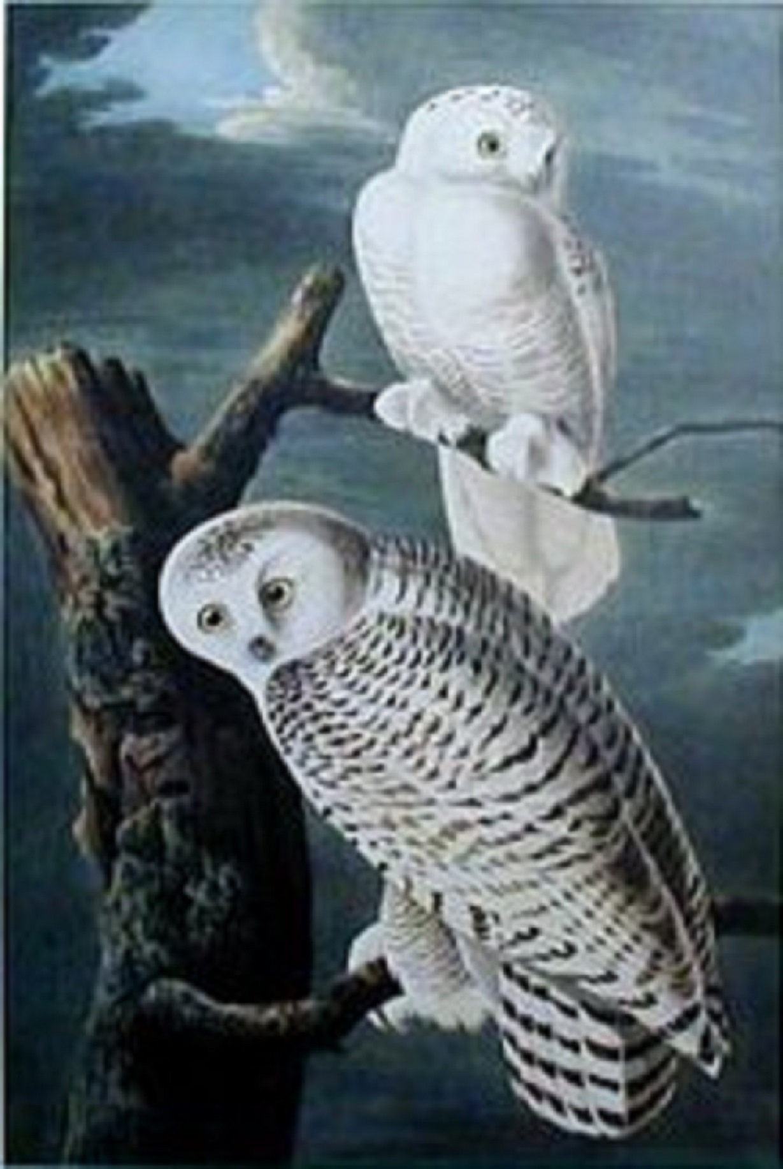
“Snowy Owl”
- John James Audubon

Slide 14
“Dream”
- Barbara Nechis

