Slide 1
URban Graffiti
Portfolio Assignment

Slide 2
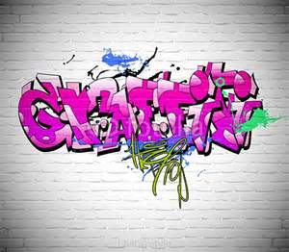
Some people think graffiti is vandalism. Some people see graffiti as art. What do you know about graffiti?

Slide 3
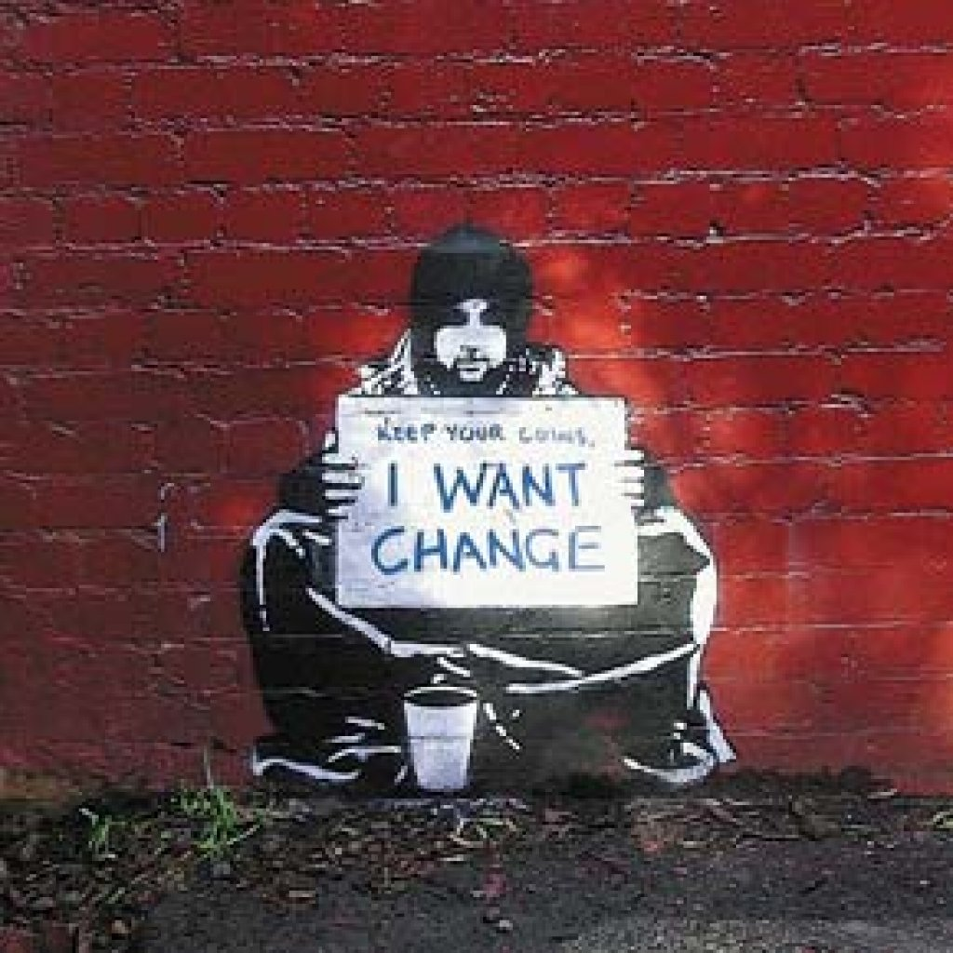
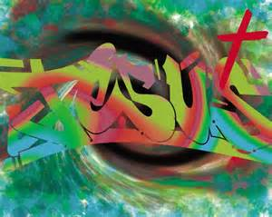
Graffiti can express social, political or religious messages.

Slide 4
Despite what people think about graffiti, it can be very detailed, artistic, beautiful and exquisite.

Slide 5
Urban or Graffiti Art
We often see Urban or Graffiti art on abandoned buildings in inner city neighbourhoods, or in back alleys of suburban neightbourhoods.
Graffiti tags often show associations to illegal groups like gangs. But graffiti “artists” say they use graffiti to express social and political messages.
Graffiti range from simple written words to elaborate wall paintings, and they have existed since ancient times, with examples dating back to Ancient Egypt, Rome and Greece.
Most modern graffiti is created with spray paint or markers.

Slide 6
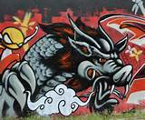

Slide 7
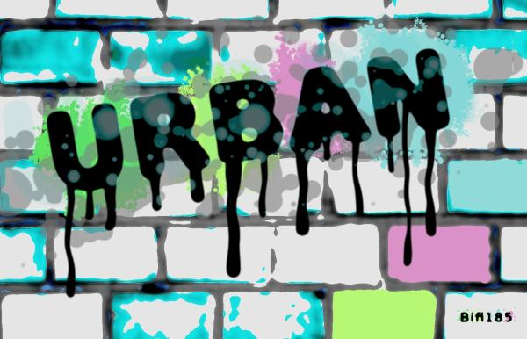

Slide 8
Assignment Requirements
Your name is done is a graffiti-like style (Can be your full name, just first or last name, or your nickname). It may also include an image, but MUST include at least your name.
Background covers the entire portfolio and suggests an urban structure – ie: brick wall, fence, steel etc.
Bright colors, black outlines to POP the words and images.
Excellent Care and Craftsmanship – sketch design in your sketchbook first then complete with acrylic paint.
You will have four full Art classes to complete your painted portfolios.

Slide 9
http://schooart.weebly.com/graffiti-creator.html

