Slide 1
The Elements of Art
The Building Blocks of Artworks

Slide 2
The Elements of Art are the building blocks used by artists to create a work of art.
Whether you are drawing, painting or sculpting, you will use these elements in some way

Slide 3
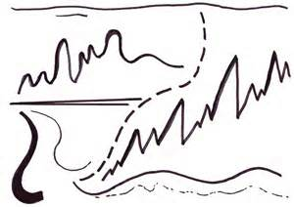
Line is a mark with greater length than width. Lines can be horizontal, vertical, or diagonal; straight or curved; thick or thin.

Slide 4
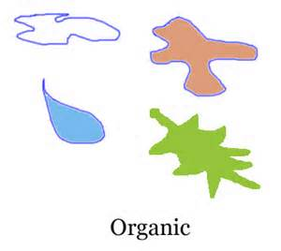
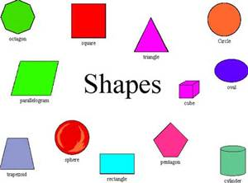
Shape is a closed line. Shapes can be geometric, like squares and circles; or organic, like free-form or natural shapes. Shapes are flat and can express length and width.

Slide 5
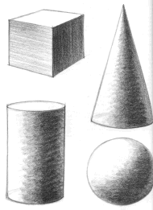
Forms are three-dimensional shapes expressing length, width, and depth. Balls, cylinders, boxes, and pyramids are forms.

Slide 6
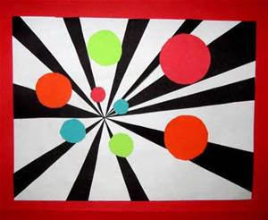
Space is the area between and around objects. Space can also refer to the feeling of depth. Real space is three-dimensional; in visual art, when we create the feeling or illusion of depth, we call it space.

Slide 7
Color is light reflected off of objects. Color has three main characteristics: hue (the name of the color, such as red, green, blue, etc.), value (how light or dark it is), and intensity (how bright or dull it is).
White is pure light; black is the absence of light.
Primary colors are the only true colors (red, blue, and yellow). All other colors are mixes of primary colors.
Secondary colors are two primary colors mixed together (green, orange, violet).
Intermediate colors, sometimes called tertiary colors, are made by mixing a primary and secondary color together. Some examples of intermediate colors are yellow green, blue green, and blue violet.

Slide 8
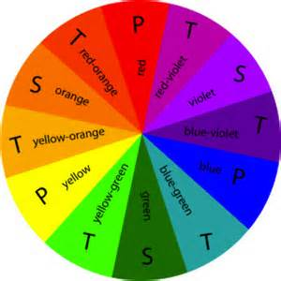

Slide 9
Value is the lightness or darkness of
a color or shades of black and white (grayscale)

Slide 10
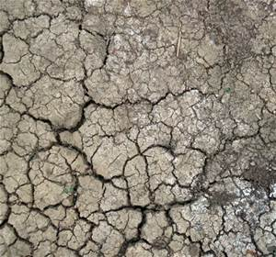
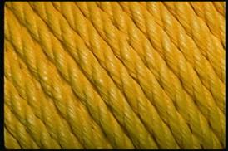
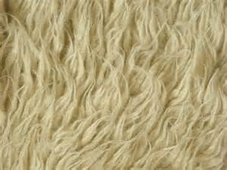
Texture is the surface quality that can be seen and felt. Textures can be rough or smooth, soft or hard. Textures do not always feel the way they look; for example, a drawing of a porcupine may look prickly, but if you touch the drawing, the paper is still smooth.

Slide 11
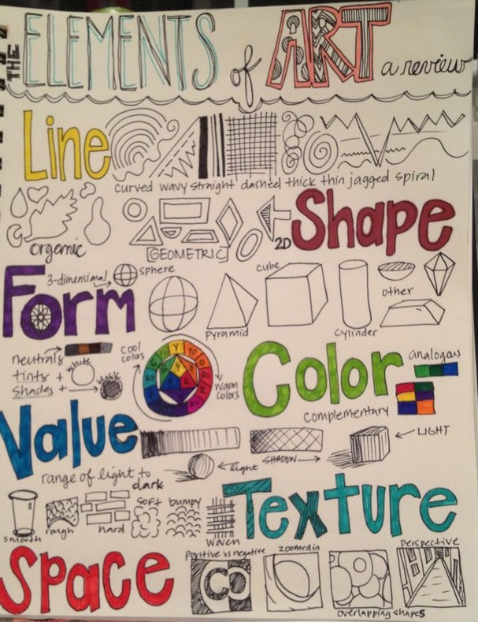
Assignment: Create a one page “review sheet which describes and shows an example of all seven Elements of Art.
You should have a one sentence description or definition of each element. You can use
Draw your examples with pencil or sharpie and use Pencil Crayons or Felt Markers to add color and decoration.

