Slide 1
Section 3.3
Triangulation, Parallax and Doppler effect

Slide 2
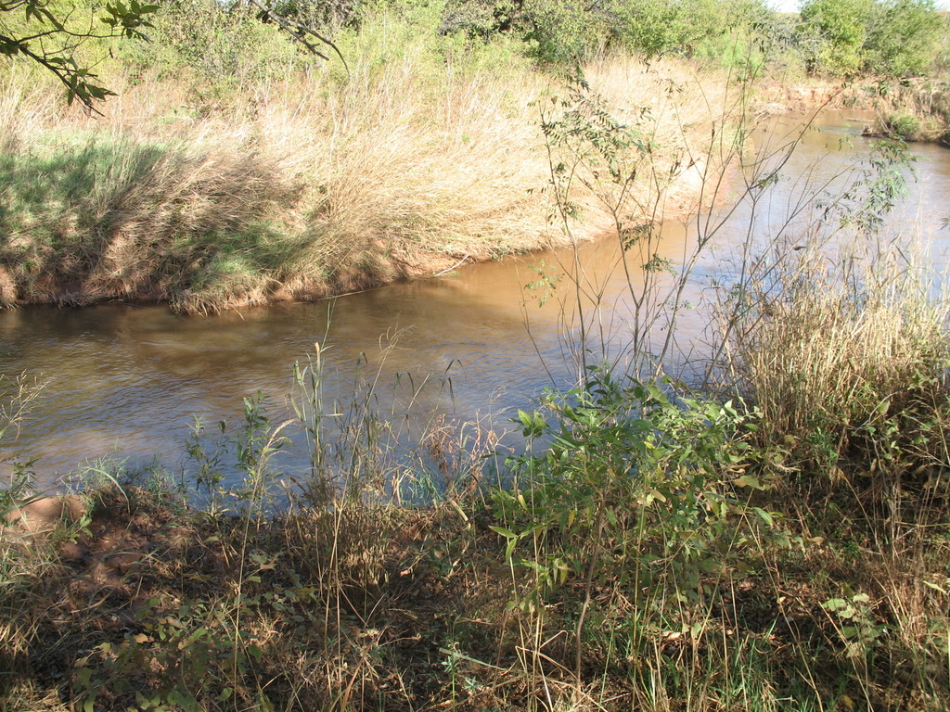
Using triangulation to measure the distance across a river without actually crossing the river…
Point on the distance object
Angles to be measured
BASELINE

Slide 3
Steps for triangulation:
Measure a baseline
Stand at one end of the baseline and measure the angle with a protractor to determine the angle between the end of your baseline and the object.
Go to the other end of the baseline and measure the angle between the end of your baseline and the object
Make a scale drawing using the length of the baseline and the two angles
On your drawing, mark a perpendicular line from the baseline to the object. Measure this line and use the scale to convert it to actual length. This will give you the distance across the river.
Notes:
SUMMARIZE THIS IN YOUR NOTES.

Slide 4
Example 1
You’re trying to cross a river and you would like to know what the distance is from where you’re standing to a tree on the other side. You measure out a baseline of 100m. Angle A is 75° and angle B is 65°. What is the distance across?
Step one: What scale of drawing will you use?
1 cm = ?
Step two: measure your angles
Step three: draw straight lines using your angles
Step four: draw a perpendicular line from the baseline to your object.
Step four: measure this final line, and convert it into actual distance.

Slide 5
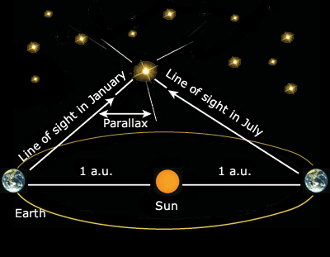
Parallax
Parallax is the apparent shift in
position of a nearby object when
the object is viewed from two
different places.
Astronomers use a star’s parallax to determine what angles to use when they triangulate the star’s distance from the Earth.
The larger the baseline, the more accurate the result.
The longest baseline that astronomers can use is the diameter of Earth’s orbit

Slide 6
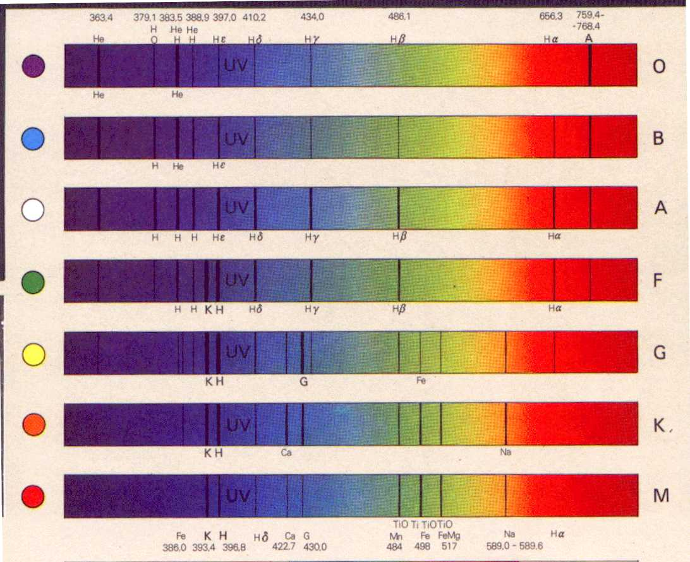
Star’s composition – using a spectrometer

Slide 7
Doppler Effect
http://www.wwnorton.com/college/geo/egeo/animations/ch1.htm
http://galileoandeinstein.physics.virginia.edu/more_stuff/flashlets/doppler.htm
Big Bang Theory…
http://www.youtube.com/watch?v=Y5KaeCZ_AaY
http://www.youtube.com/watch?v=J43lAESftPs&NR=1

Slide 8
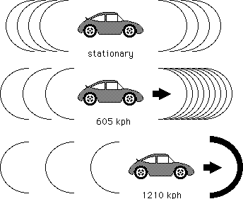
Determining A Star’s Direction Of Motion
A change in the pitch (frequency) of sound waves because they are stretched or squeezed is known as the Doppler effect.
Think of an ambulance coming towards you and then leaving, what happens to the sound?
Changes in the sound waves can be measured to determine how fast and in what direction a light-emitting object is moving.

Slide 9
Red shift, Blue shift
The dark bands move in response to the light waves of a moving star.
BLUE SHIFT – toward the blue end, means the star is approaching earth
RED SHIFT – toward the red end, means the star is moving away from the earth
NO SHIFT – star and earth are moving in the same direction (star is stationary).

Slide 11
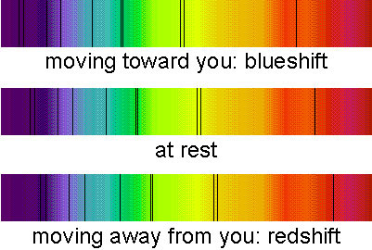

Slide 12
RED BLUE SHIFT animations
http://www.wwnorton.com/college/geo/egeo/animations/ch1.htm

Slide 13
Complete the following:
Use your notes, power point and textbook section 3.0 to use triangulation to determine the distance of an object in the classroom or the hallway (MUST STAY CLOSE TO THE ROOM).
Work in groups of 3 or 4

