Slide 1
The Principles of Design
How to use the Building Blocks of Artworks
Reference: www.getty.edu

Slide 2
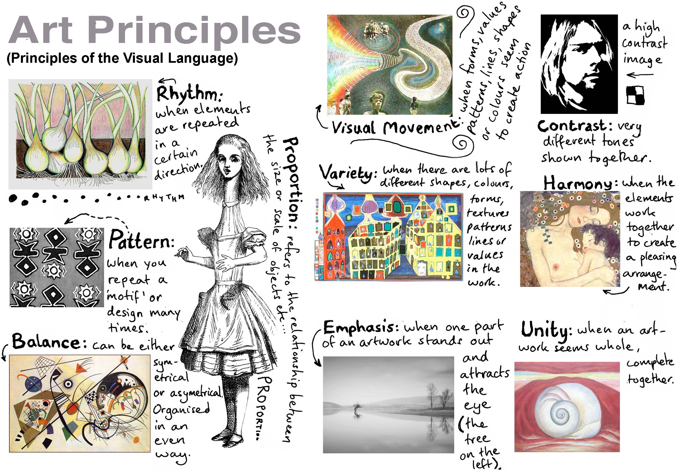
The Principles of Art are what allows artists to create works, using the building blocks of art.
Whether you are drawing, painting or sculpting, you will use these principles in some way

Slide 3
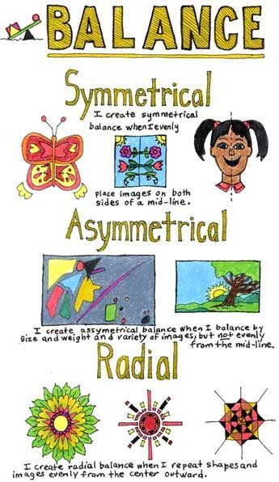
Balance is the distribution of the visual weight of objects, colors, texture, and space. If the design was a scale, these elements should be balanced to make a design feel stable.
In symmetrical balance, the elements used on one side of the design are similar to those on the other side;
in asymmetrical balance, the sides are different but still look balanced.
In radial balance, the elements are arranged around a central point and may be similar.

Slide 4
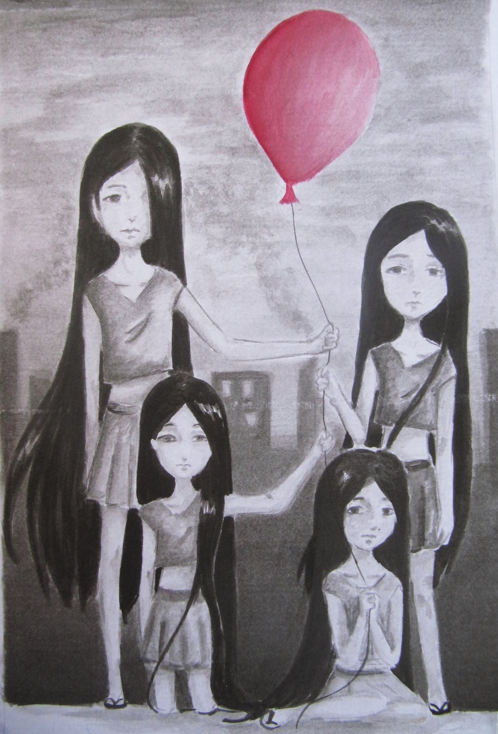
Emphasis is the part of the design that catches the viewer’s attention. Usually the artist will make one area stand out by contrasting it with other areas. The area could be different in size, color, texture, shape, etc.

Slide 5
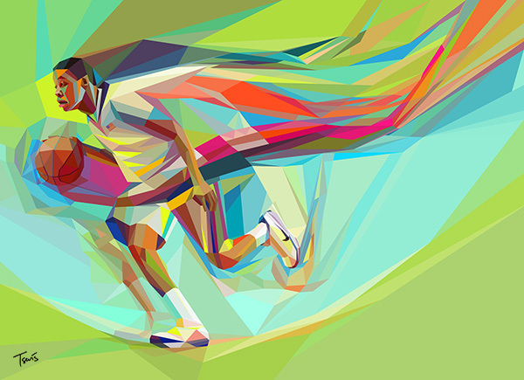
Movement is the path the viewer’s eye takes through the work of art, often to focal areas. Such movement can be directed along lines, edges, shape, and color within the work of art.

Slide 6
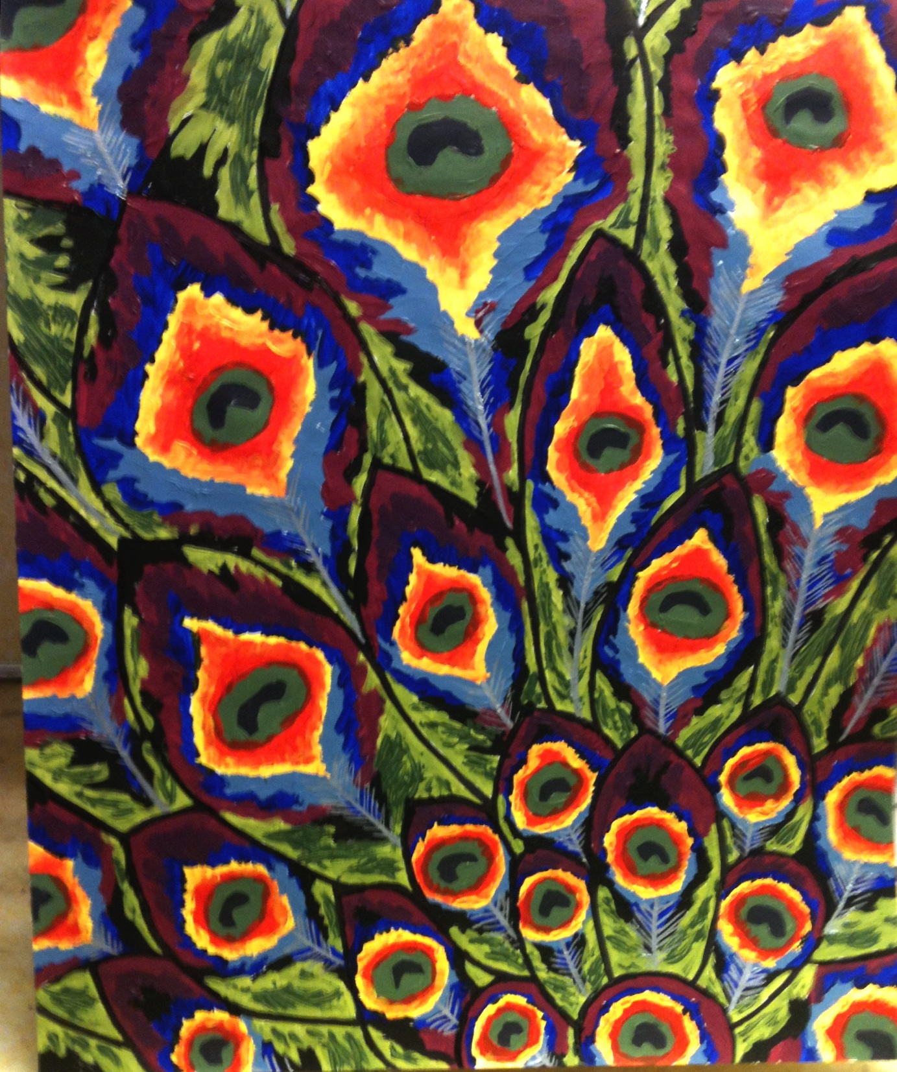
Pattern is the repeating of an object or symbol all over the work of art.

Slide 7
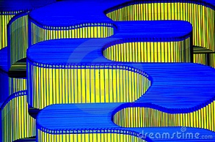
Repetition works with pattern to make the work of art seem active. The repetition of elements of design creates unity within the work of art.

Slide 8
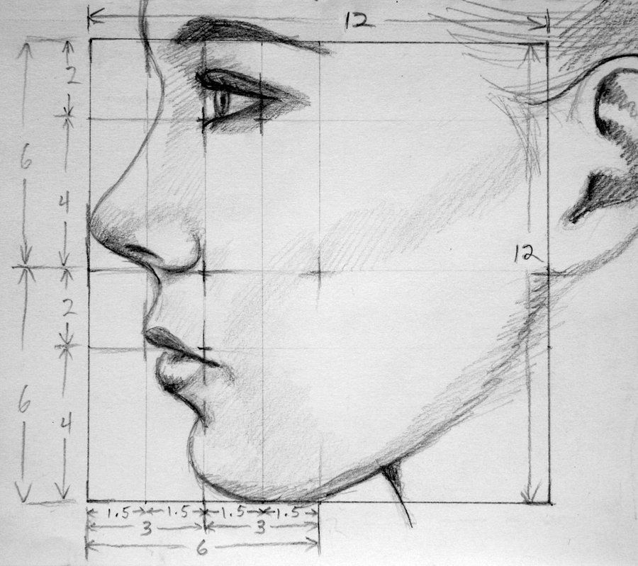
Proportion is the feeling of unity created when all parts (sizes, amounts, or number) relate well with each other. When drawing the human figure, proportion can refer to the size of the head compared to the rest of the body.

Slide 9
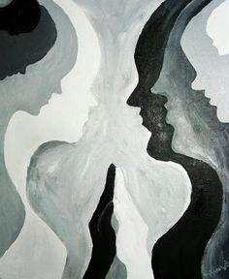
Rhythm is created when one or more elements of design are used repeatedly to create a feeling of organized movement. Rhythm creates a mood like music or dancing. To keep rhythm exciting and active, variety is essential.

Slide 10
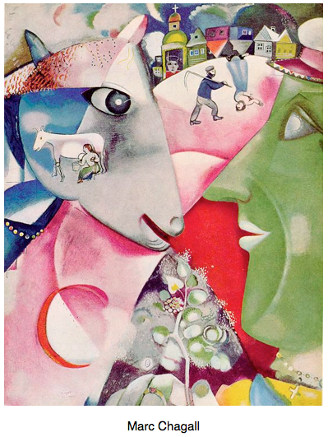
Variety is the use of several elements of design to hold the viewer’s attention and to guide the viewer’s eye through and around the work of art.

Slide 11
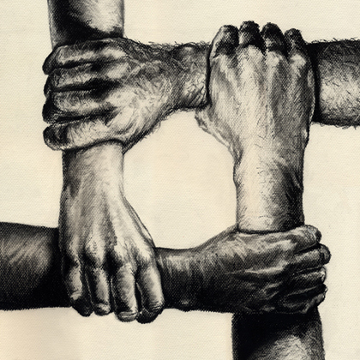
Unity is the feeling of harmony between all parts of the work of art, which creates a sense of completeness.

Slide 12
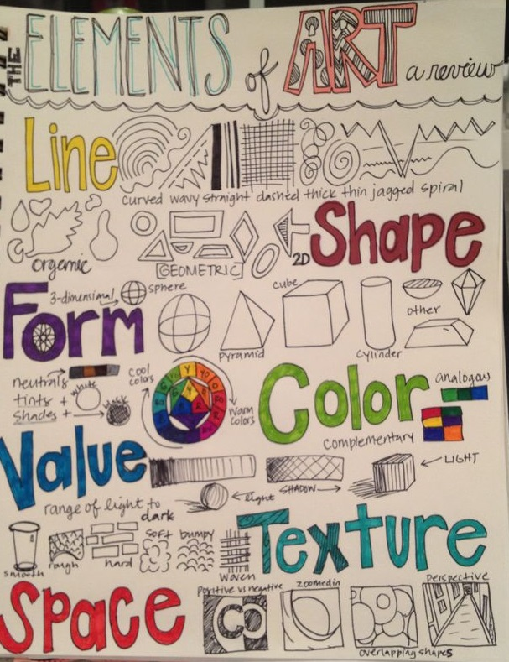
Assignment: Create a one page “review sheet which describes and shows an example of all nine Principles of Art.
You should have a one sentence description or definition of each element.
Draw your examples with pencil or sharpie pen and use Pencil Crayons or Felt Markers to add color and decoration.

