Slide 1
Unit 2 Plants for Food and Fibre

Slide 3
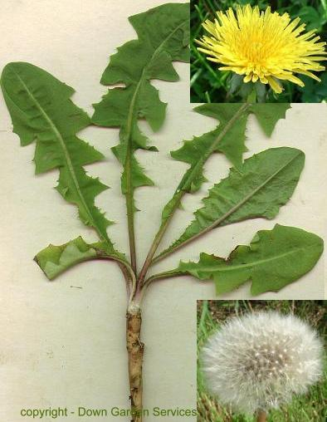
Structure of a Plant
Leaves
Photosynthesis
Gas exchange
Stem
Xylem
phloem
Roots
Diffusion, Osmosis
Taproot, root hairs
Fibrous roots

Slide 4
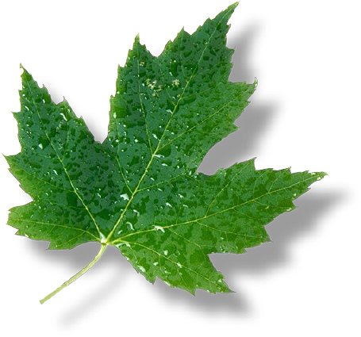
Leaves
Site of Gas exchange CO₂/O₂ (stomata)
Transpiration
water vapour released from leaves
Energy produced from the sun by photosynthesis (producers)
Deciduous: leaves fall off in autumn
Coniferous: needles lose less moisture

Slide 6
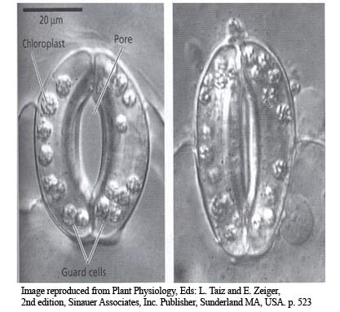
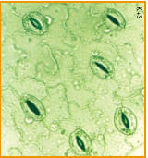
Stomata
Holes which allow carbon dioxide and oxygen to enter/leave
Also allows moisture (water) to exit (transpiration)
Opened and closed by guard cells

Slide 7
Photosynthesis (day)
The green pigment chlorophyll makes leaves green, and absorbs sunlight
Carbon dioxide is taken in (and water and nutrients)
Oxygen and sugar are produced
CO₂ + H₂O --> O₂ + C₆H₁₂O₆

Slide 8
Cellular Respiration (night)
Plants breathe in oxygen, and exhale carbon dioxide (just like us!)
O₂ + C₆H₁₂O₆ --> CO₂ + H₂O

Slide 9
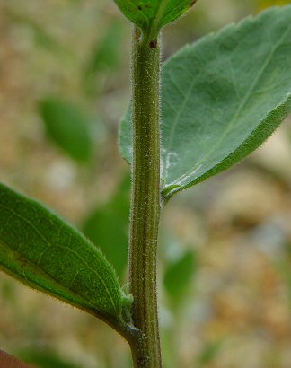
Stem function:
1)Support
2) transport (vascular tissue)

Slide 10
Stem-transport tissues
Xylem-transports water and nutrients up the plant from the roots (xy-high)
Phloem-transports food (sugar) down the stem to the roots (phlo-low)
Layers-see pg 108

Slide 11
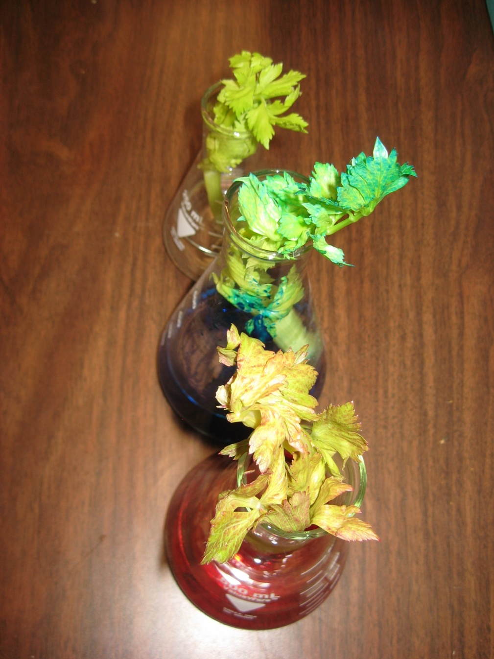
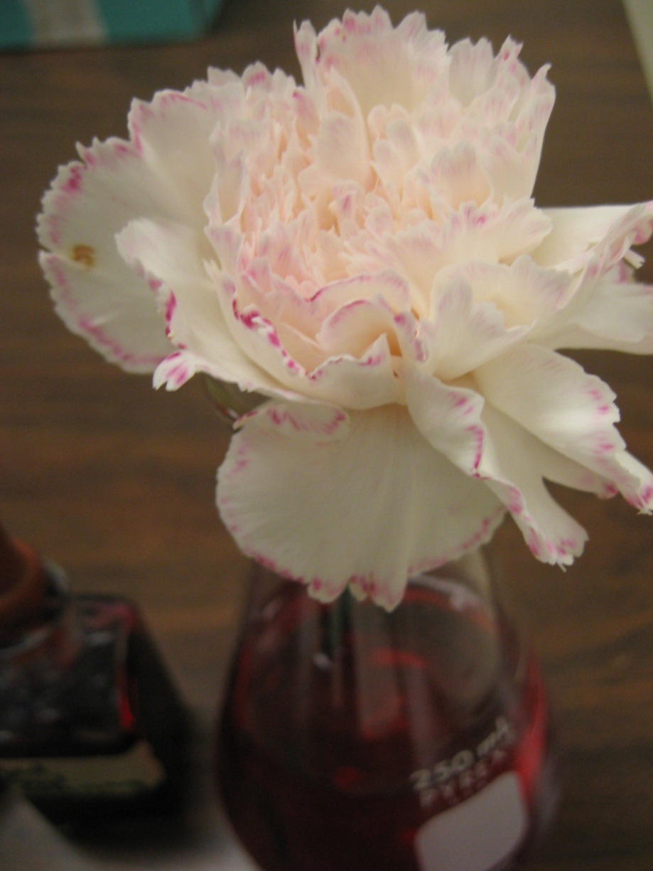

Slide 12
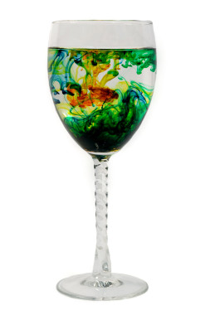
Diffusion
Diffusion takes place when particles spread out from an area of high concentration to an area of low concentration
HIGH TO LOW

Slide 13
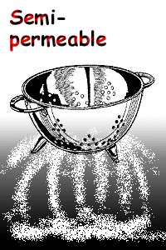
Types of membranes
Permeable
Semi-permeable
Impermeable

Slide 14
Impermeable membrane

Slide 15
Permeable membrane

Slide 16
Semi-permeable membrane

