Slide 1
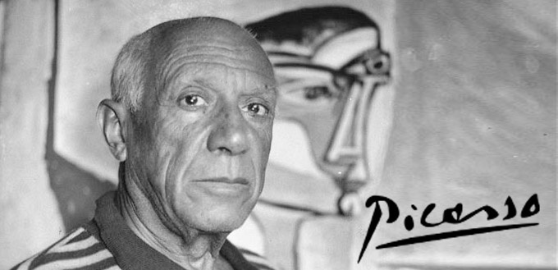
1881 – 1973

Slide 2
Pablo Picasso was born in 1881. His family lived in Malaga, Spain, where his father taught art.
He was considered a prodigy and mastered many art skills at an early age.

Slide 3
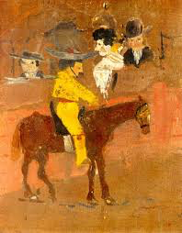
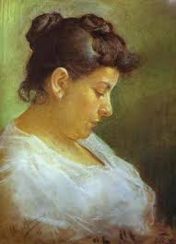
Picasso’s first painting was completed at the age of 8.
At age 15, he used pastel to create this portrait of his mother.

Slide 4
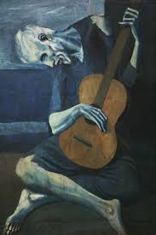
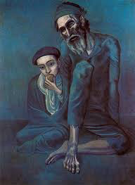
The BLUE Period
1901 – 1904
Picasso moved to France with a fellow painter who died shortly after. This influenced much of his works; a period that became known as the Blue Period.
Picasso started to make a name for himself at this time. The art world was impressed with the young artist.

Slide 5
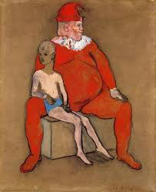
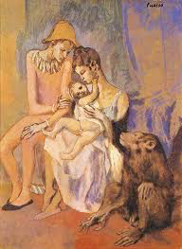
The ROSE Period
1905 – 1906
Picasso took interest in circus performers and the world of acrobats. His work became more jovial.
Picasso was becoming famous. His art was right for the times!

Slide 6
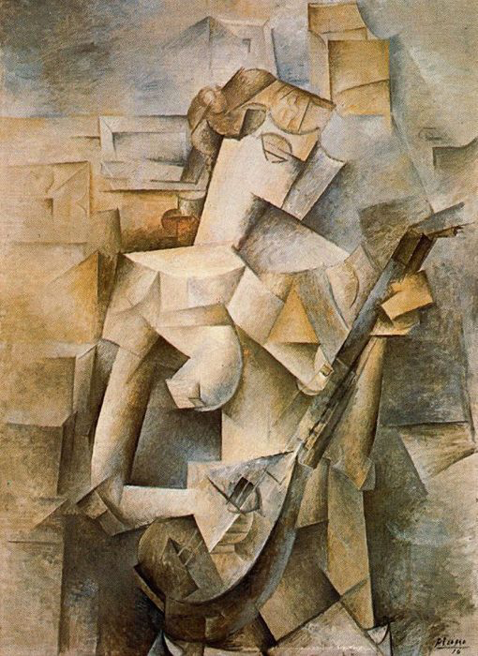
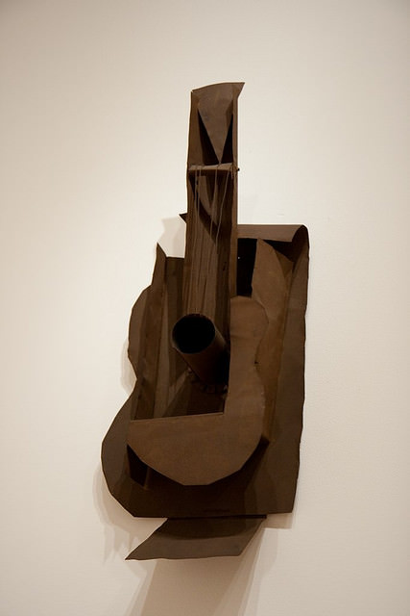
Cubism
1906 – 1915
Picasso was interested in African sculpture and the way it distorted the body into imaginative shapes.
This began a new experimental stage of his career called cubism.
Not everyone was convinced that this style was “art”. It no longer depicted classical form. They were intrigued though, and his fame continued.

Slide 7
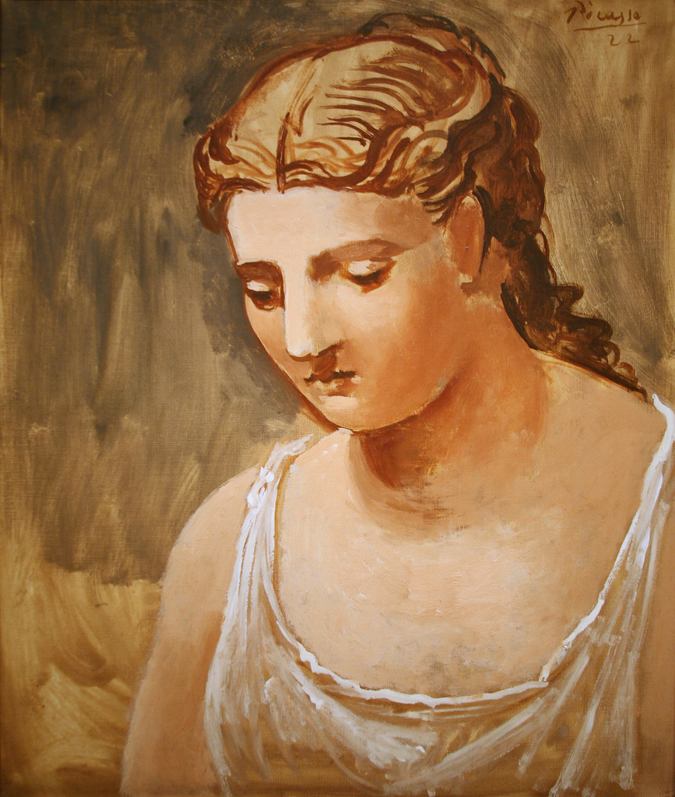
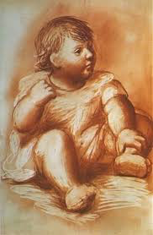
The Classical Period
1916 – 1925
Picasso met his wife, a ballerina named Olga during this period. His artworks were brighter and sunnier. He went back to his classical form
Picasso got his style “back” according to the art world. But was this a good thing? Critics suggested he lost his edge.

Slide 8
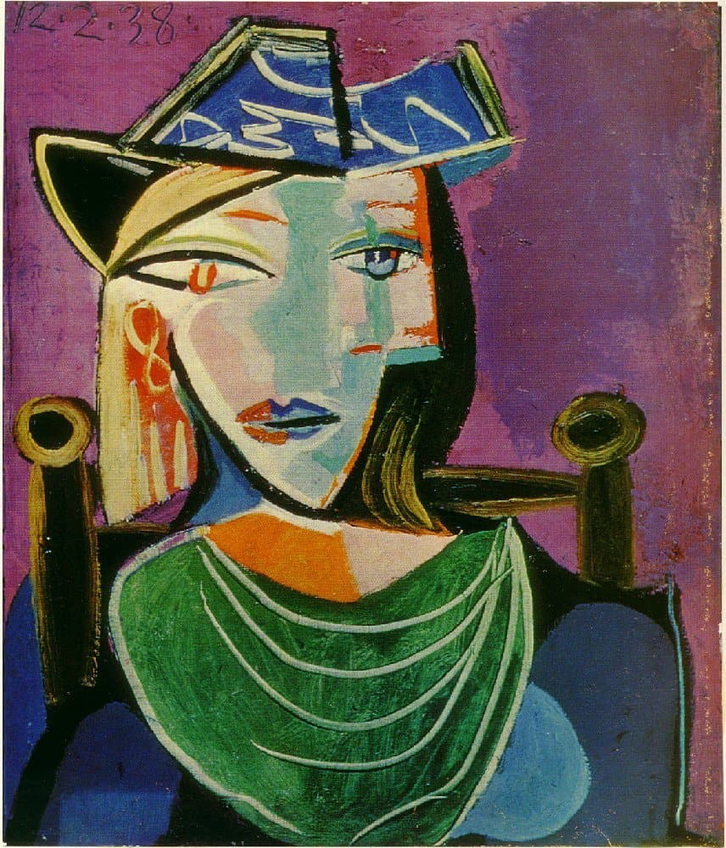
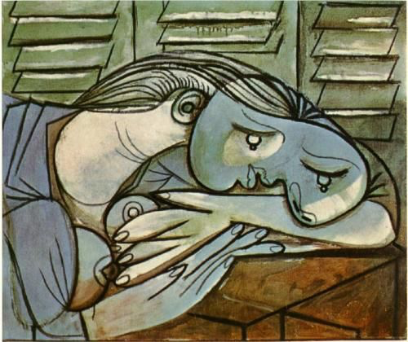
Surrealism
1925 – 1934
Picasso became involved with a group known as the Surrealists. They were interested in the world of dreams and spontaneity.
Not everyone was ready for this new movement in the world of art and literature. It was a risk!

Slide 9
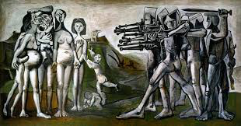
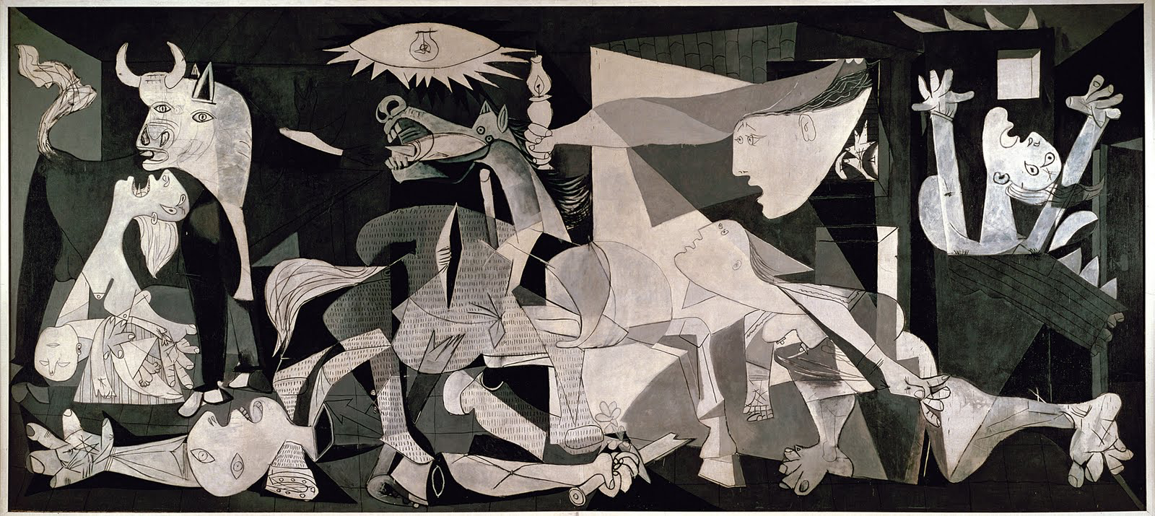
Barbarism
1937 – 1950s
Picasso had now lived through 2 world wars. Living in Paris during times of turmoil created an edge to his work. He depicted many scenes of war at this time.

Slide 10
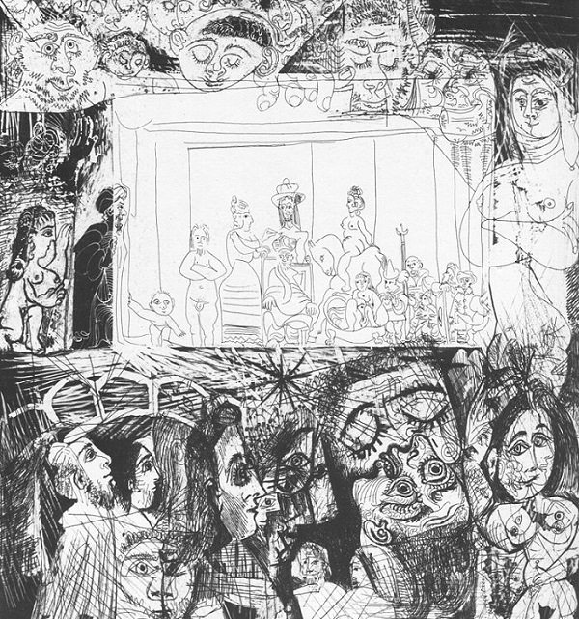
The Final Years
1954 – 1973
Picasso spent his final years working with other artists and reworking their masterpieces. He continued to create some independent art pieces.
Despite fame in some circles, many thought he became artist

