Slide 1
Mosaic Color Wheel
Grade 7 Art

Slide 2
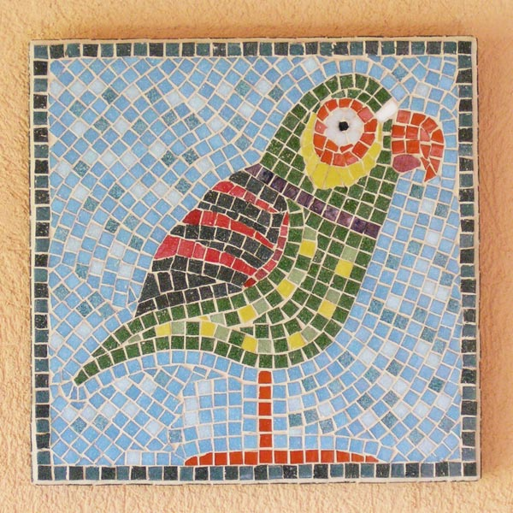
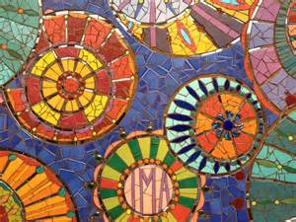
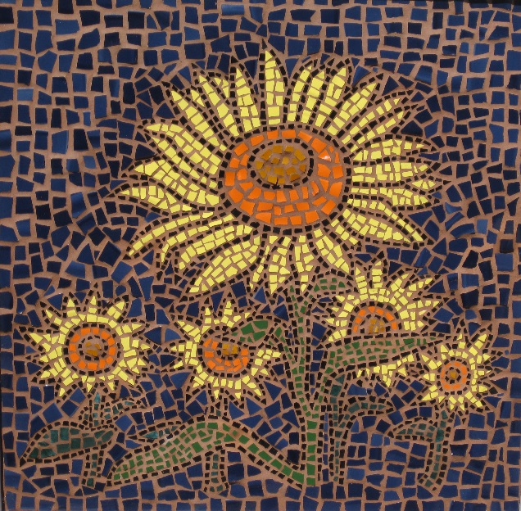
Mosaic
Mosaic is the art of creating images with many small pieces of colored glass, stone, or other materials.
We will be creating a color wheel using small pieces of paper in different colors.

Slide 3
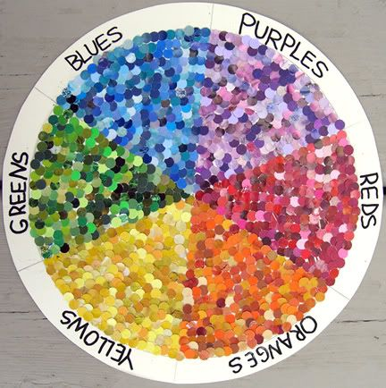

Slide 4
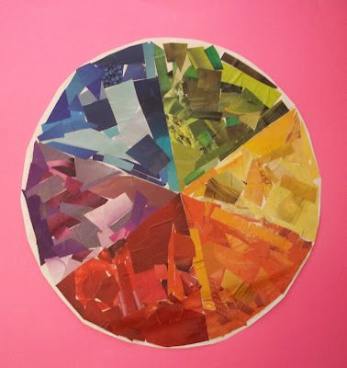

Slide 5
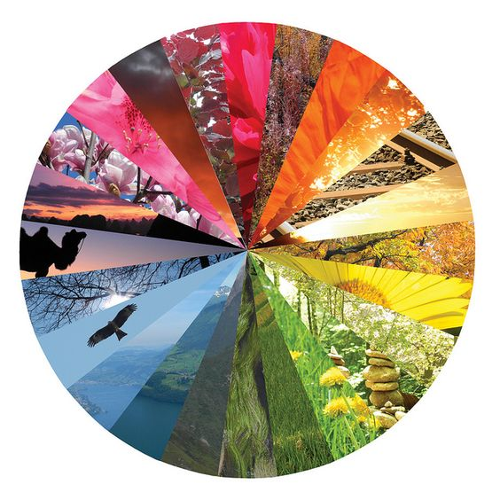

Slide 6
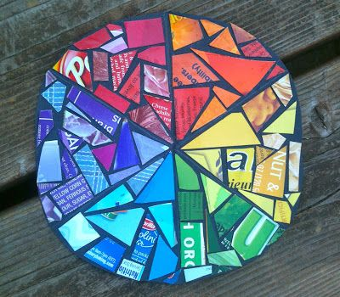

Slide 7
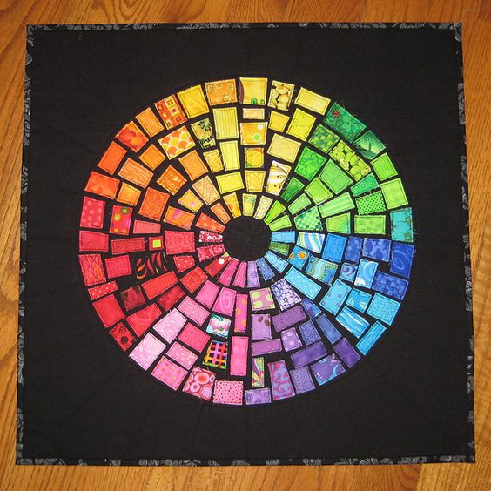

Slide 8
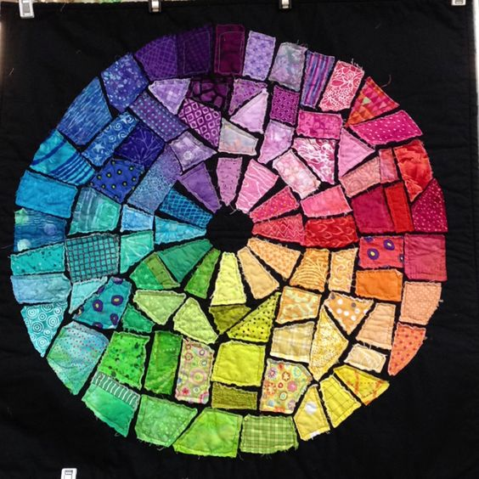

Slide 9
Assignment
You will be making a SIX part color wheel focusing on the primary and secondary colors.
Look through magazines to collect light, medium and dark shades of Red, Orange, Yellow, Green, Blue and Violet
You may also use wrapping papers, origami or scrapbook papers. Do not use plain/solid colors…each paper should have a picture or pattern on it.
Lightly draw a large circle on your paper as your guide.
Rip the papers into small pieces. Keeping each color in a pie shape, arrange the pieces from lightest in the centre of the circle to darkest on the outside edge. Glue each piece down with a glue stick.
Care and Craftsmanship will be very important to the success of this project!

