Slide 1
2.1 Variation
Inherited and Acquired Traits

Slide 2
By the end of this class…
You will know whether the eyes on Jack Sparrow’s face are…
Inherited OR Acquired

Slide 3
Characteristics =
Traits
You are a UNIQUE individual
You have THOUSANDS of characteristics that make you YOU
Characteristics are also called TRAITS
Eg. Hair colour, hockey skillz, etc.

Slide 4
Traits can be: PHYSICAL
Physical Traits:
Describe the way something looks
Describes the internal structure
Fur Colour
Ear Shape
Number of Legs
Placement of eyes
Brain Structure
Shapes of Kidneys

Slide 5
Traits can be: BEHAVIOURAL
Describes the way some ACTS
Describes something that was LEARNED
Fetching
Hibernating
Migration
Language

Slide 6
Types of Traits are:
OR
ACQUIRED
INHERITED

Slide 7
Inherited (Heritable) Traits
These are coded in you DNA
They have been passed down to you by your BIOLOGICAL parents
Sometimes instinct is considered to be inherited
Since these traits are coded in your DNA, they are passed down from one generation to the next.
height
eye colour
flying south for the winter

Slide 8
Acquired Traits
These traits develop throughout your life (an organism is NOT BORN with it)
You do not have traces of this trait in your DNA
THESE ARE:
Things you learn (riding a bike)
Things that happen to you (purple hair)

Slide 9
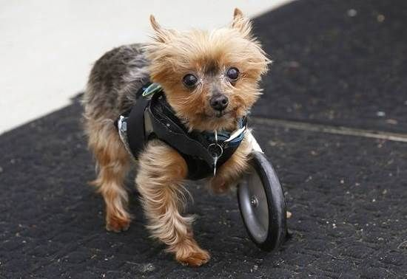
Acquired traits START and END with you!
These CANNOT be passed down through generations
Organisms develop these traits over time
They are NOT in your DNA
For Example:
This dog’s puppies will NOT be born with 3 legs and a wheel; they will (most likely) have 4 legs

Slide 10
Physical Traits are both:
INHERITED and ACQUIRED

Slide 11
Behavioural Traits are both:
INHERITED and ACQUIRED

Slide 12
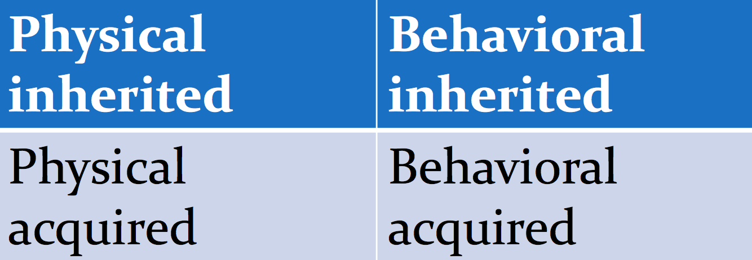
Let’s Practice
For each example, identify whether you think the trait is:
Think:
“ Was this organism programmed from birth to have this trait?”
“Did the trait develop during the organisms life?”
INHERITED
ACQUIRED

Slide 13
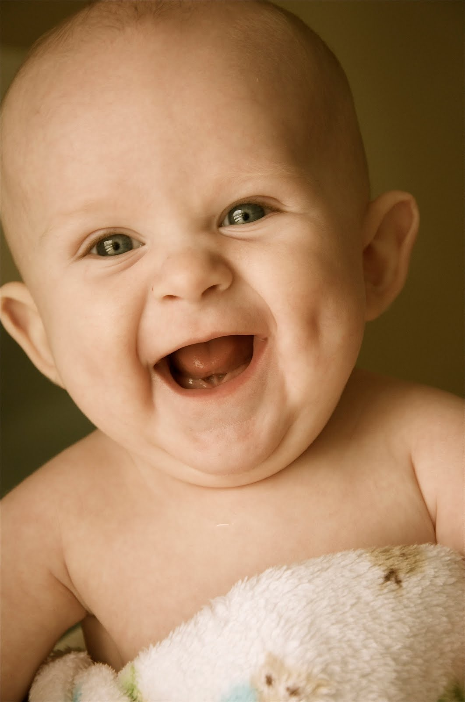
Dimples
INHERITED

Slide 14
You are bilingual
ACQUIRED

Slide 15
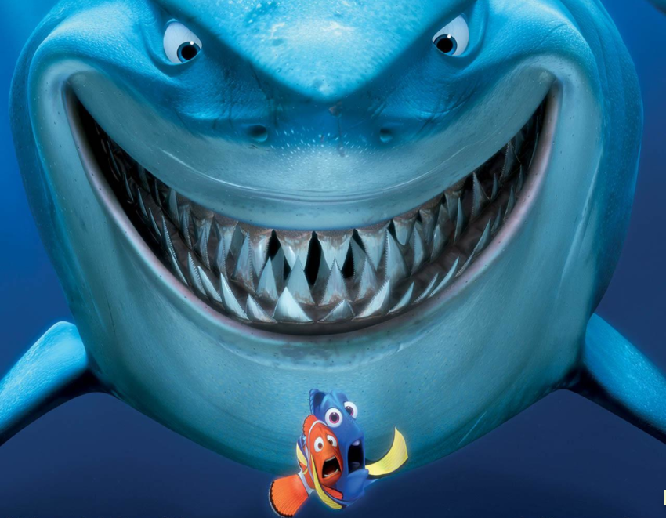
As a human, you can swim!
ACQUIRED

Slide 16
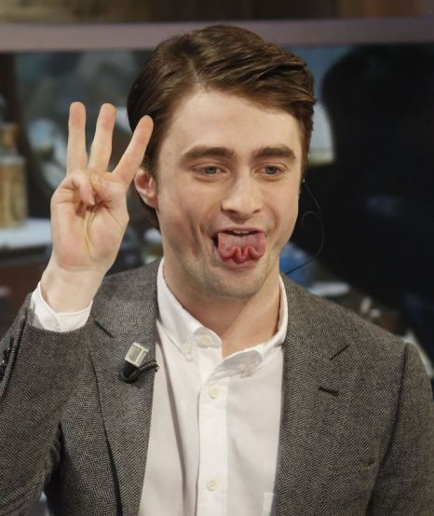
You can “W” your tongue
INHERITED

Slide 17
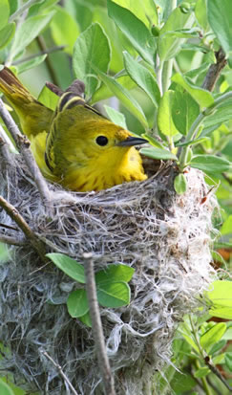
A bird sits on it’s nest
INHERITED

Slide 18
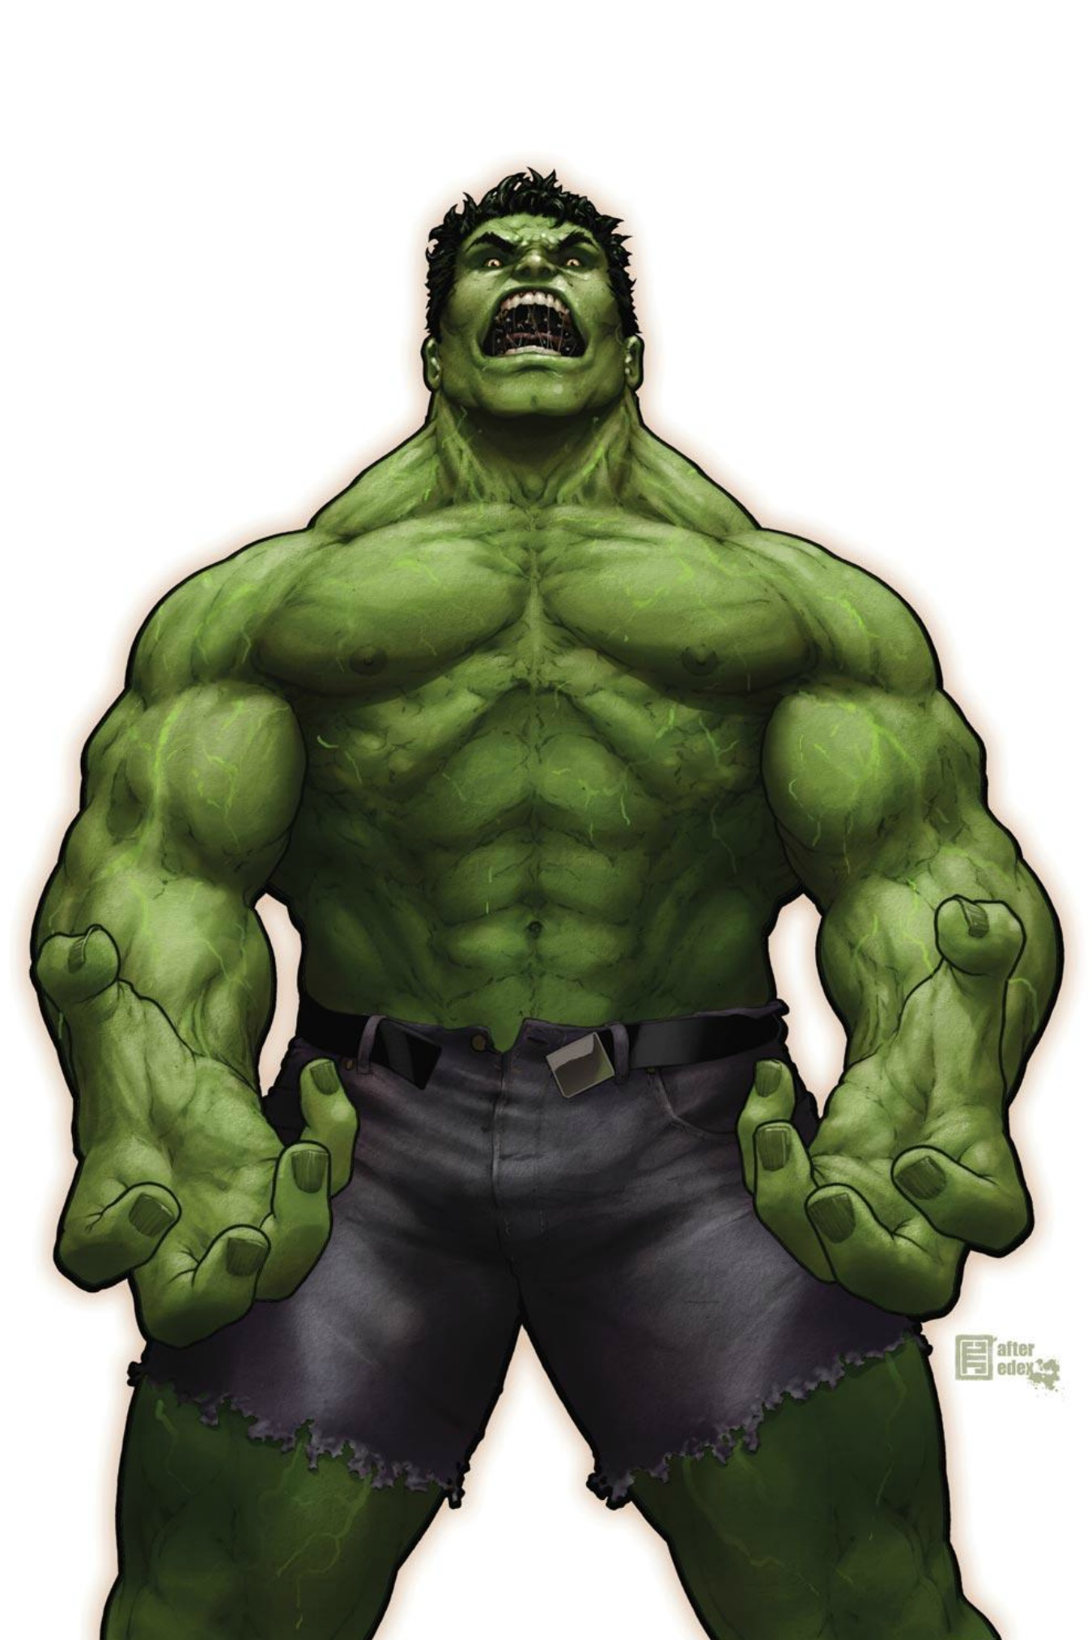
Your muscles are defined
ACQUIRED

Slide 19
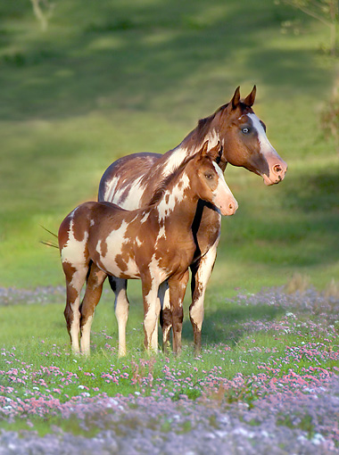
Spots on a coat
INHERITED

Slide 20
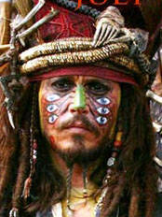
Jack Sparrows “eyes” are…
Inherited OR Acquired?

Slide 21
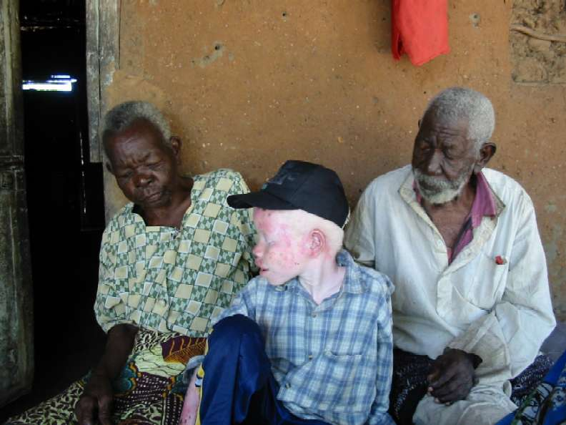
Discrete vs Continuous Variation
Discrete Variation: differences in characters that have a definite form
(ex) being albino
You are either albino or not
Continuous Variation: differences in characteristics that have a range of forms
(ex) human height which is a range

Slide 22
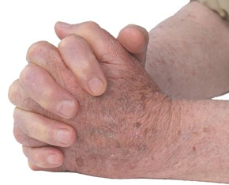
Try This….
Close your eyes and clasp your hands
Which thumb is on top??
Is this discrete or continuous variation?

Slide 23
YOUR TURN…
Learning Tasks Include:
Card Sorts
Colouring Pages
Task Cards
Challenges
Mazes
Games
… anything else?
Survey your group.
Make a list of your inherited traits and your acquired traits, discrete traits and continuous traits.
Create a learning task to help reinforce these outcomes, keeping in mind your personal traits.

