Slide 1
The Elements of Art
Reviewing the Building Blocks of Artworks

Slide 2
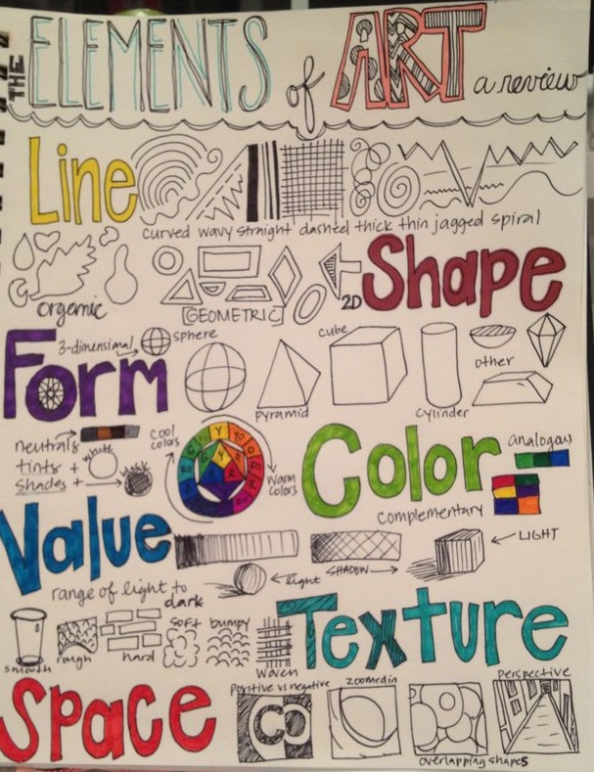
The Elements of Art are the building blocks used by artists to create a work of art.
Whether you are drawing, painting or sculpting, you will use these elements in some way

Slide 3
Line is a mark with greater length than width. Lines can be horizontal, vertical, or diagonal; straight or curved; thick or thin.
Shape is a closed line. Shapes can be geometric, like squares and circles; or organic, like free-form or natural shapes. Shapes are flat and can express length and width.

Slide 4
Forms are three-dimensional shapes expressing length, width, and depth. Balls, cylinders, boxes, and pyramids are forms.
Space is the area between and around objects. The space around objects is often called negative space; negative space has shape. Space can also refer to the feeling of depth. Real space is three-dimensional; in visual art, when we create the feeling or illusion of depth, we call it space.

Slide 5
Color is light reflected off of objects. Color has three main characteristics: hue (the name of the color, such as red, green, blue, etc.), value (how light or dark it is), and intensity (how bright or dull it is).
• White is pure light; black is the absence of light.
• Primary colors are the only true colors (red, blue, and yellow). All other colors are mixes of primary colors.
• Secondary colors are two primary colors mixed together (green, orange, violet).
• Intermediate colors, sometimes called tertiary colors, are made by mixing a primary and secondary color together. Some examples of intermediate colors are yellow green, blue green, and blue violet.
• Complementary colors are located directly across from each other on the color wheel (an arrangement of colors along a circular diagram to show how they are related to one another).
Value is the lightness or darkness of a color or shades of black and white (grayscale)

Slide 6
Texture is the surface quality that can be seen and felt. Textures can be rough or smooth, soft or hard. Textures do not always feel the way they look; for example, a drawing of a porcupine may look prickly, but if you touch the drawing, the paper is still smooth.

Slide 7
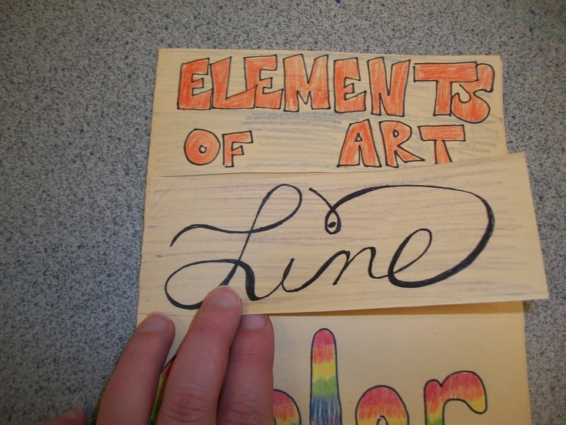
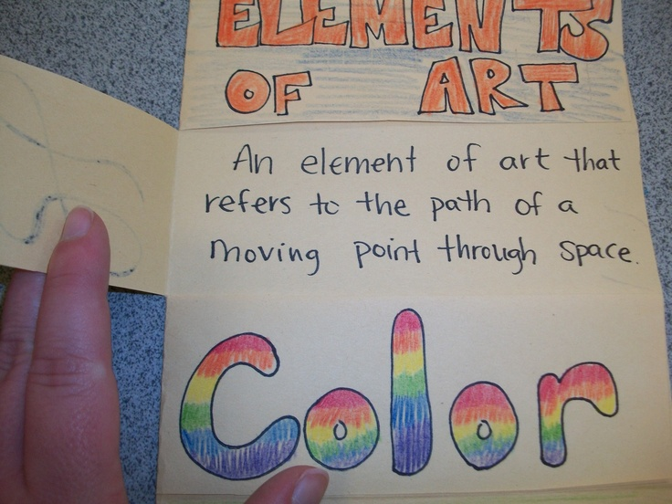
Assignment: Create an interactive “Foldable” for your sketchbook to review all the Elements of Art.
Fold a sheet of paper in your sketchbook in half toward the coils of your book
Divide your page in half, then in half again & then one last time in half. You will have 8 sections.
Cut along the folds to the folded edge
Each “flap” will have one of the Elements of Art on the front and will open up to reveal a sample and the definition
Label and decorate the front of each flap with the name of an Element
Write the definition on the inside, under the corresponding flap. (Use the glossary in the purple Art In Action text… if we have it! OR use this presentation/your information sheet from your Zen Tangle task)

