Slide 1
Drawing the Figure
Learning Human Proportion
from Leonardo da Vinci

Slide 2
In this unit we will be studying the work of Leonardo da Vinci who researched the human body and developed guidelines that are used in many applications today. Artists still use these guidelines to understand human proportions and accurately draw them.
After our study we will create color drawings of the human figure in action.

Slide 13
With a partner, use the proportion guide in your sketchbook to “check” how close your body measurements are. Measure and record each of these:
Total Height:
Arm span:
Head - chin to top of head:
Head to top of legs:
Head to wrists:
Top of legs to ground:
Wrists to ground:

Slide 15
After watching the video, recreate the proportion diagram in your sketchbook. Go back to review the video if needed, or use the proportion guide in your sketchbook for help in drawing the human figure. Make sure to draw the guidelines (8 equal parts)
Now we will be placing the human figure into various poses and noticing what happens to the proportion of the body parts. Think about how the body moves during activities such as skiing, skating, running, walking, skateboarding etc. Choose your favorite activity. you may want to find photos or magazine pictures of people doing this activity.
Use a wooden mannequin and gently move its’ body parts into a pose that would be typical of the activity you chose. Sketch the pose in your sketchbook, using the proportion guide and the techniques you’ve learned and practiced. The next step will be to complete a full color drawing of the figure in action on 12 x 18 inch paper, using colored pencils or watercolor pencils.

Slide 16
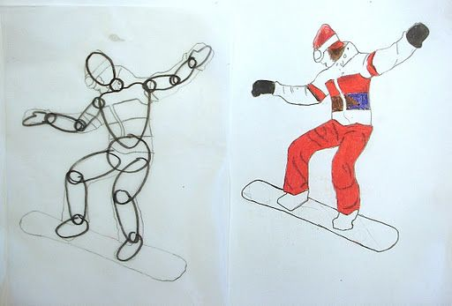
Student samples from http://arteascuola.com/

Slide 17
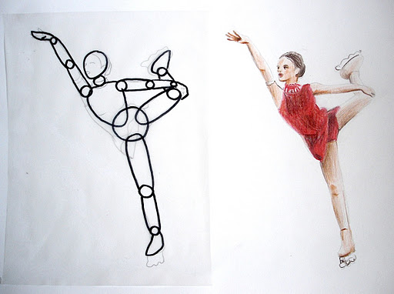

Slide 18
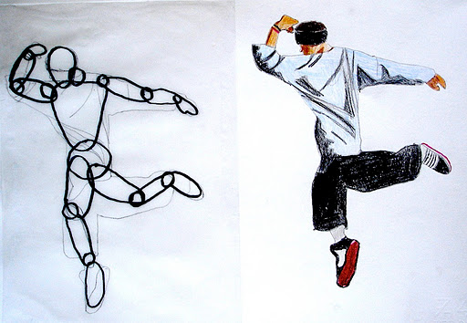

Slide 19
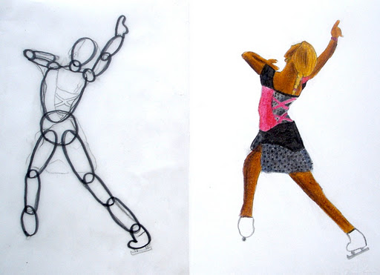

Slide 20
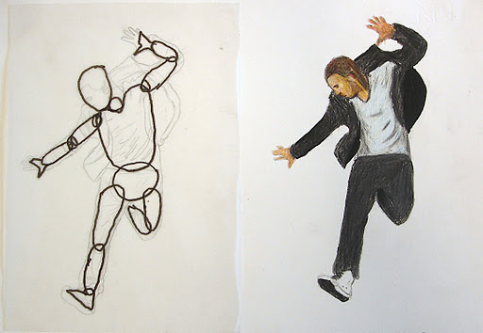

Slide 21
