Slide 1
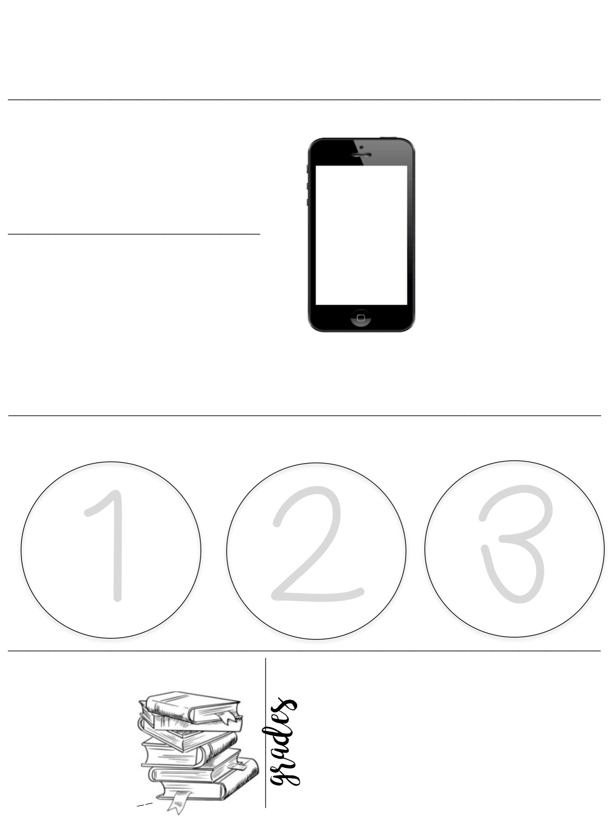
Junior High Art
Mrs. Bruce
2018 -----
----- 2019
communication
Seventh grade
Text @art7olg to (807) 788-2048
1 amanda.bruce@cssd.ab.ca
2 Remind101 app chat * text message alerts
3 (403) 500-2124 (OLG School Phone Number)
TEXT
MESSAGE ALERTS
Eighth grade
Text @art8olg to (807) 788-2048
the Bruce Zone
Ninth grade
Text @art9olg to (807) 788-2048
www.thebrucezone.weebly.com
Stay up to date on our class webpage to see your artwork and that of your classmates. Some coursework will be updated here as well!
Sign up for the class text alerts for updates on homework and school events. Download the Remind App to be access these messages for all your classes & extracurricular groups.
responsibility and preparation
Start working on
bell ringers immediately. The 1st 5 minutes is for free sketching. These sketches will be graded each term.
Work must
be turned in on the due date. While deadlines in art are flexible, there will be a hard cut off for major projects.
Come
prepared to
class with your sketchbook, planner, drawing tools, and personal supplies
Class Materials
22½ %
22½ %
22½ %
22½ %
10%
Personal Sketchbook (provided)
Exploring Colour
Final Project
____
Intro to Art
Drawing & Sketching
Creating Form
Artist Pencils
________
Personal Agenda
________
Unit Breakdown – Portfolio: 60%, Sketchbook: 30%. Critique: 10%

Slide 2
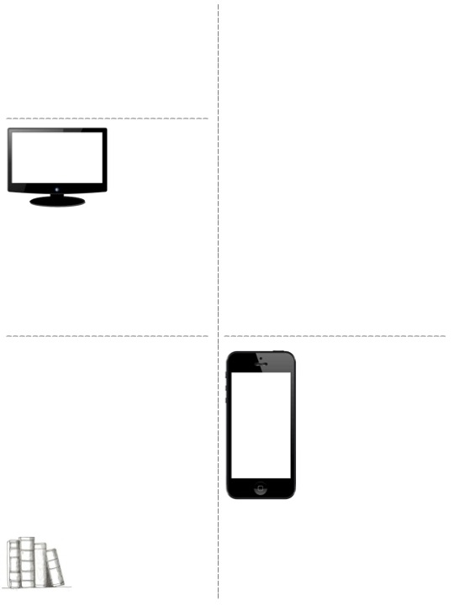
food and drink policy
policy for absences & grades
In general, food and drinks are allowed. This is contingent on it not becoming a distraction in class, and as long as students can handle the responsibility. This policy is subject to change at my discretion, and at any time. BE AWARE THAT FOOD/DRINK CAN DAMAGE YOUR ARTWORK.
If you are absent, you are responsible for completing all work missed. If you know you are going to be absent in advance, you should ask me for your work BEFORE the absence. The sooner the better – if you ask the day before, that’s not soon enough!
All missed assignments will be placed in your classes “extra files” folder. It may also be linked in D2L or on the Bruce Zone. It’s your responsibility to ask a classmate or me for help on making up any tasks (you can always come in during BruceTime for extra support with this).
assignment formatting
All typed assignments must be in a 12 PT FONT that is clear and easy to read. Work must be double-spaced, and have 1” margins with your name, class, and date in the top corner with a centered title.
I have one computer and one iPad in my classroom for students to use to type, research, and engage. Chromebooks will be available when signed out.
Sketchbooks
Sketchbooks will be collected throughout the course of the year. All guided and independent tasks must be completed and properly labeled. A PROPERLY completed sketchbook will document your artistic growth throughout the year, and is one of the most important tools for a developing artist.
homework
electronic devices
Students should not have significant homework throughout the year. Major projects will be given a specific timeline with 2 due dates. The original date is the soft date where students can either complete their work or have a “free form” class to experiment with any of the tools in the art room. Please note, that students will NOT get to enjoy “free form” until their work is submitted. The final deadline is the class immediately following the original due date.
Electronic devices must be kept secured at all times (in your pencil case or pocket. Devices should not be out during class unless instructed by the teacher or with permission.
There is a phone chart at the front of the class for those who need it.
While a rare occurrence, if students do not complete work during class, in the time allotted, it will be assigned as homework.
1st offense: Student will turn the phone into the teacher until the end of class.
2nd offense: Student will turn the phone into the teacher and parents will be contacted.
3rd offense: Phone will be turned into office and parents will be notified for a meeting to discuss.

Slide 3
Parents:
Please take the time to review the preceding information with your child.
Communication between school and home is key to ensure the success of every student. This is your child and you have a say in how they are educated! If you have any questions about the course information, please do not hesitate to call me directly at the school, or send me an email.
Most important information for you:
1) Get to know D2L. Login, have your child show you their classes, and save the password on your computer for easy access throughout the year. You can use this to access the newsfeed providing information about what is happening in class and to see your child’s grades. Comments will be included with specific assignments when necessary. This is also where you can read about any assignments your child has submitted late!
2) Download the remind app on your phone or personal device. Text your child’s class code to (807) 788-2048. Don’t forget to include their TA code as well. This one-way messaging app provides you with homework deadlines and reminders about important events in our school
3) Find the class webpage (www.thebrucezone.weebly.com) and navigate through each unit. Assignments and information will be posted there regularly.
Communication
Please detach this sheet and keep the top half for yourself. Please return the bottom portion with your child to me no later than: Friday, September 7th
Child’s Name: ___________________
Parent Name: ______________________ Email: _________________________________________
Parent Name: ______________________ Email: _________________________________________
Phone Number: ____________________ The best time to call is: _________________________
Parent Signature: ________________________ Student Signature ________________________
I’m looking forward to an amazing year working with you and your child at OLG.

Slide 4
Optional Supplies:
Personal Artist Sketching Pencils
Your child has been enrolled in the Fine Arts: Art option for the 2018 – 2019 school year. We will be completing a variety of sketching assignments throughout the school year. In art, the more opportunities to practice the more skills will improve. Having the write tool to practice is essential!
We are providing students with the opportunity to purchase a personal set of sketching pencils with a wider range than those in the school supply. Please keep in mind that the school does have supplies that your child is welcome to use; however, students may elect to purchase their own set. This pencil set will be your child’s property and they may take them to and from school at will.
Students may purchase sets for $10.00. Each set includes 12 FineTec artist quality graphite sketching pencils, with a value scale of 4H to 6B. If you would like to purchase a pencil set, please fill in the form below and return to Mrs. Bruce no later than Friday, September 7, 2018.
Thank you for your support of the JH art program at Our Lady of Grace School.
Order Form
Please detach this sheet and keep the top half for yourself. Please return the bottom portion with your child to me no later than: Friday, September 7th
Child’s Name: ___________________
Parent Name: ______________________ Email: _________________________________________
☐ I do not want a pencil set at this time.
☐ I would LOVE to purchase my own pencil set! Quantity ____ X $10.00 = ______________
Cash or cheque (made payable to Our Lady of Grace School) are accepted.
I’m looking forward to the amazing artwork that will be created this year!

