Slide 1
Sec. 2.3 – Analyzing and Building Electrical Circuits
p. 311 - 315

Slide 2
Circuit Drawings
Engineers and designers of electrical circuits use special symbols that show the components and connections clearly.
Symbols make it easier to plan circuits before you build it.
Four basic parts of a circuit:
Energy source (provides electrons)
A conductor (the path)
Switch to turn it on or off
Load that converts electrical energy into another form

Slide 3
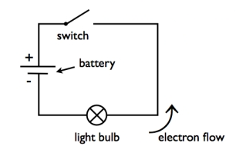
Basic Circuit

Slide 4
Symbols for circuits
Chart on page 312
Know these symbols!
Important symbols:
Conductor
Cell
Battery
Lamp
Resistor
Switch
Motor
Fuse

Slide 5
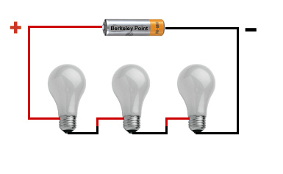
Series Circuits
There is only one pathway for the current.
If this pathway is interrupted the whole circuit cannot function.
Can be useful in a house; switches are added in series with other components (wall plugs, lights). This makes it possible to turn off all the electricity in the circuit.

Slide 6
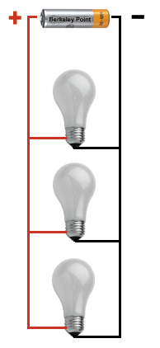
Parallel Circuits
Have separate current paths for each section of the circuit.
An interruption or break in one pathway does not affect the rest of the pathways.
Very useful for household items, especially decorative lights. On a string of Christmas lights, if one bulb goes out, the whole string won’t go out.

Slide 7
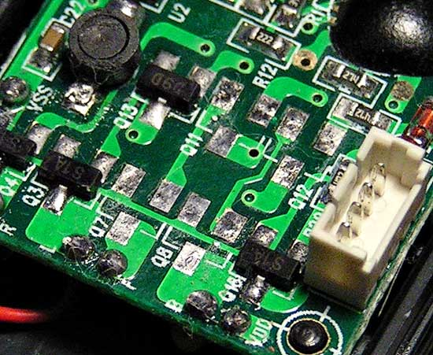
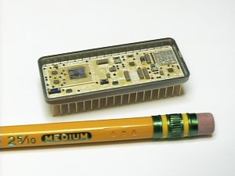
Microcircuits
Tiny circuits in advanced electronics require transistors.
A transistor is usually made of three layers of specially treated silicon. Layers are arranged in a particular way so that a small voltage in the middle controls the current on the outside.
Microcircuits contain microscopic transistors and resistors. They are extremely tiny!

