Slide 1
Floral Watercolours
You will be continuing your exploration of watercolours by completing a portfolio mini-task

Slide 2
YOUR TASK:
Create a painting depicting a flower using inspiration from the images to follow
The images were chosen due to their complexity and tonality – they are great for water colour painting
You don’t have to paint the whole flower as it appears… You may choose a close up section
Portfolio rubric applies
HAVE FUN!

Slide 4
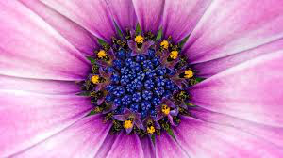

Slide 5
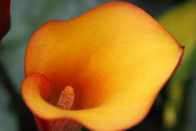

Slide 6
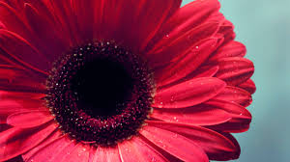

Slide 7
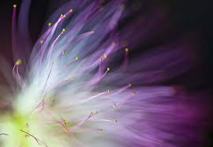

Slide 8
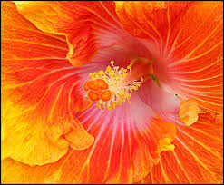
This is a
challenging
piece!!!

Slide 9
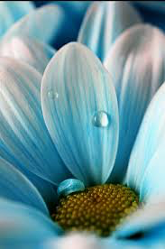

Slide 10
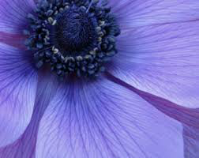

Slide 11
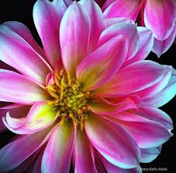

Slide 12
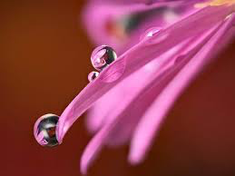

Slide 13
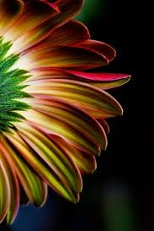

Slide 14
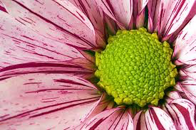

Slide 15
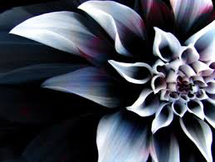

Slide 16
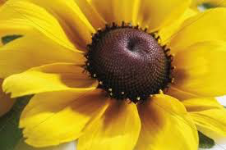

Slide 17
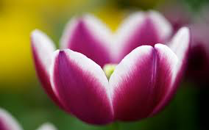

Slide 18
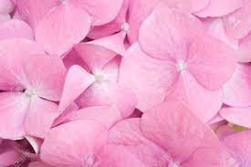

Slide 19
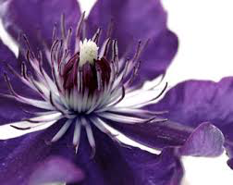

Slide 21
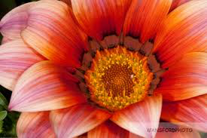

Slide 22
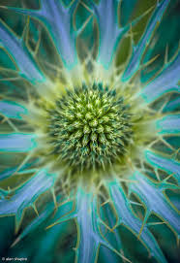

Slide 23
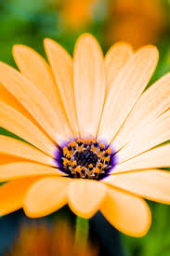

Slide 24
