Slide 1
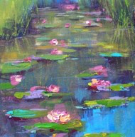
Water Lily –
Karen Margulis

Slide 2
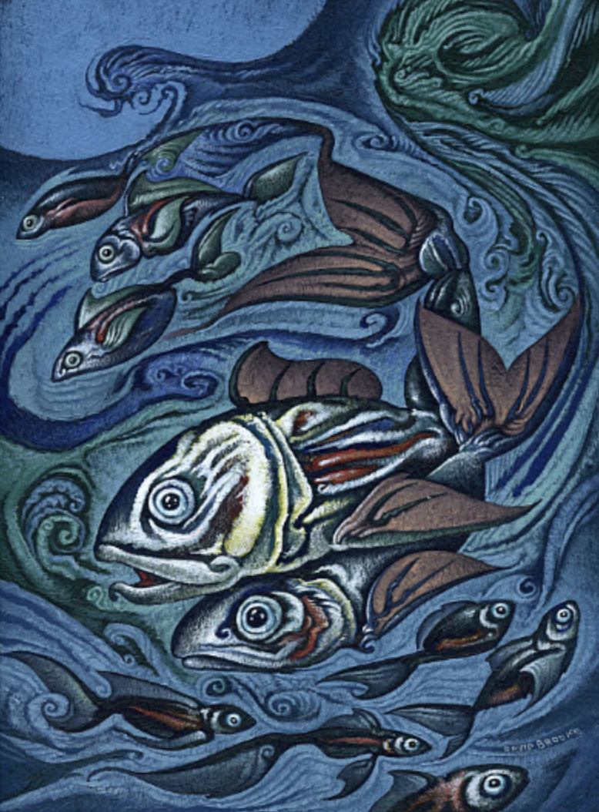
“Big Fish Small Fish”
- David Brooke

Slide 3
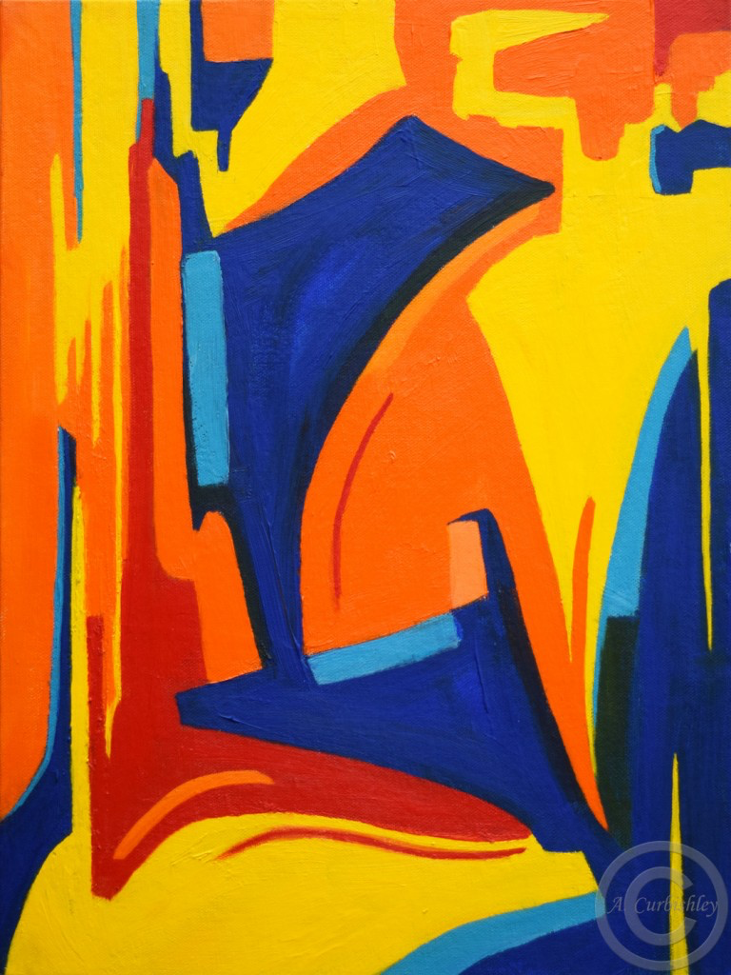
“Movement”
- Amanda Curbishley

Slide 4
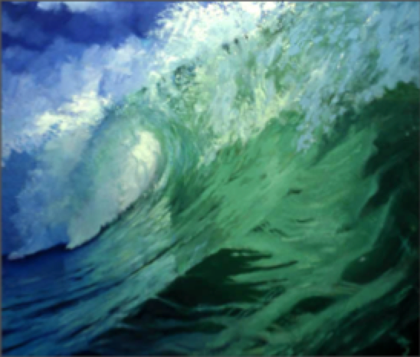
“Big Wave”
- Paul Geraghty

Slide 5
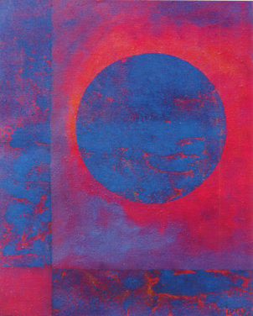
Lucy Dall’Orto

Slide 6
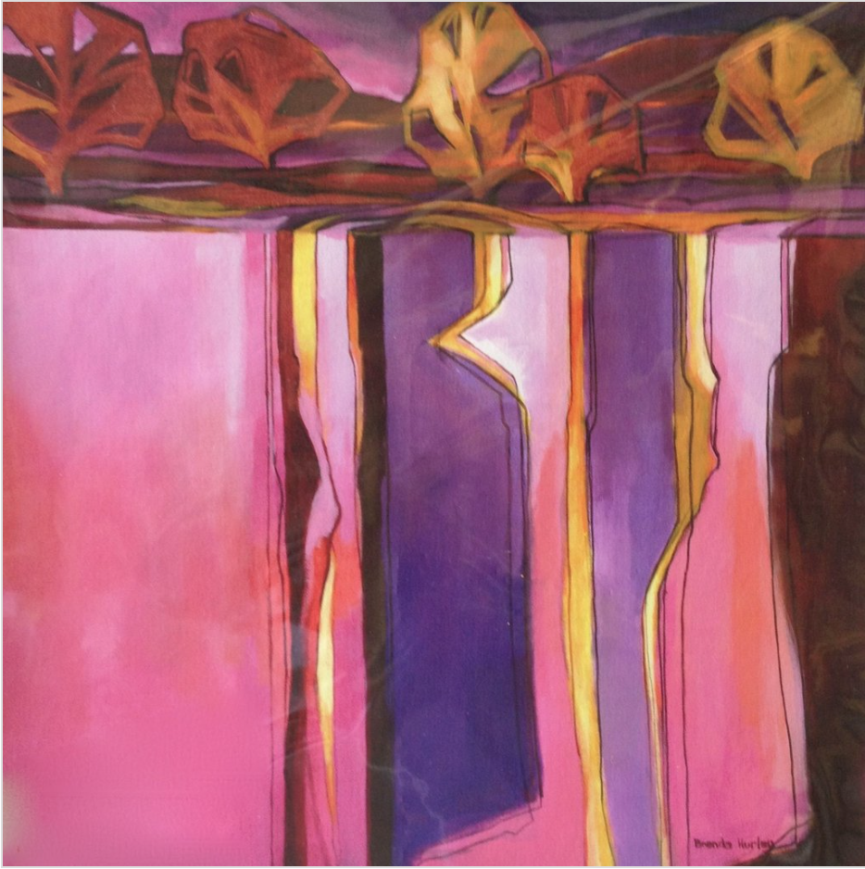
“Feel the Land”
- Brenda Hurley

Slide 7
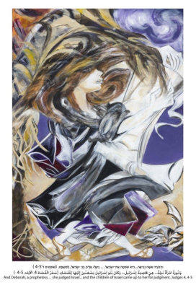
“Deborah”
Ilana Raviv

Slide 8
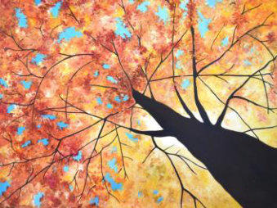
“Look up to the Light”- Gail Wareham

Slide 9
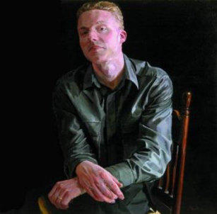
“Portrait of Matthew Clough”
- Alastair Adams

Slide 10
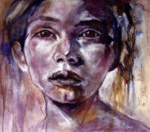
“Geisha”
- Anthony Barrow

