Slide 1
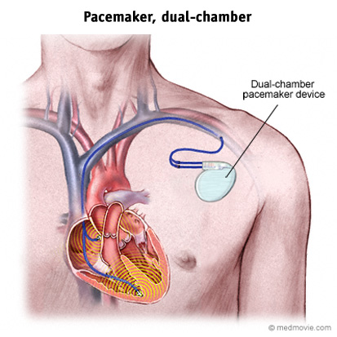
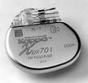
Section 1.4 Cells and Batteries
Electrochemical Cell – is a package of chemicals designed to produce small amounts of electricity. The electricity comes from chemical reactions.
There are two main types of cells:
Dry cells
Wet cells
A pacemaker uses an electrochemical cell to deliver small amount of current at a regular interval to keep the heart beating normally.

Slide 2
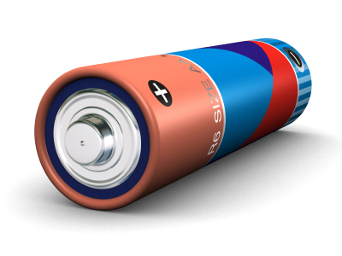
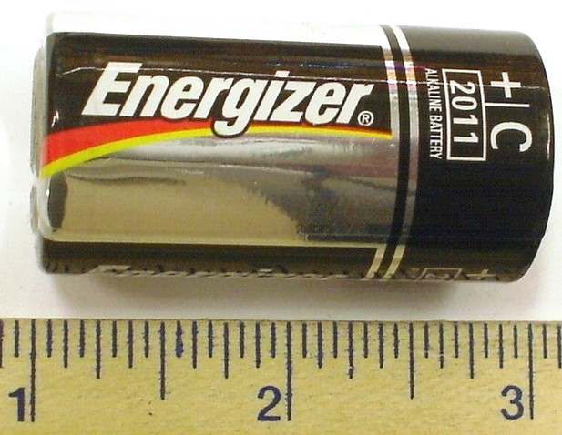
Dry Cells
The electricity-producing cells that we use everyday in flashlights and T.V. remotes are dry cells.
They are called “dry” because the chemicals are in a paste
They are sealed so they can be used in any position without the chemicals leaking out.

Slide 3
Dry Cells con’t
Dry cells work by a chemical reaction in the cell releasing free electrons.
Electrodes – a conductor through which electric current enters or leaves a device or material
Electrolyte – a paste or liquid that conducts electricity because it contains chemicals that form ions.
Ion – an atom or group of atoms that has become electrically charged through the loss or gain of electrons.

Slide 4
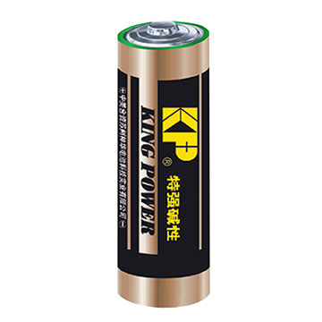
The electrolyte conducts electricity, and it reacts with the two metals (electrodes). One electrode becomes positively charged, and the other becomes negatively charged.
In a dry cell, electrons leave from the negative electrode, and return in through the positive electrode.
Positive terminal: electrons return
Negative terminal: electrons leave

Slide 5
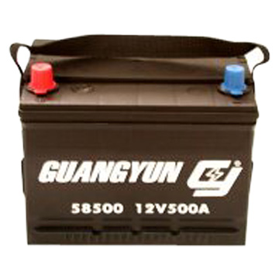
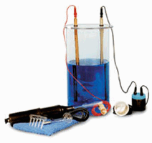
Wet Cells
A wet cell uses a liquid electrolyte that is usually an acid (such as sulfuric acid).
Early cells were wet
Cars and trucks use wet cells
Wet cells are generally cheaper to make
Must be careful however, the electrolyte is highly corrosive.

Slide 6
Wet Cells con’t
Each electrode in the wet cell reacts differently with the electrolyte.
The acid eats away at the zinc.
This leaves behind electrons, that gives the disappearing electrode a negative charge.
Zinc electrodes must eventually be replaced.
The reaction between the copper and acid leaves a positive charge, but does not eat away the copper.
Electrons move from the neg. zinc to the pos. copper. Creating a flow of electrons – electricity!

Slide 7
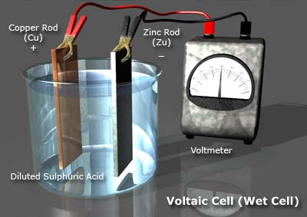
3) Electrons flow from the negative zinc to the positive copper.
2) Acid reacts with the copper leaving positive charge.
1) Acid eats away at the zinc. Leaves electrons behind. Becomes negative

Slide 8
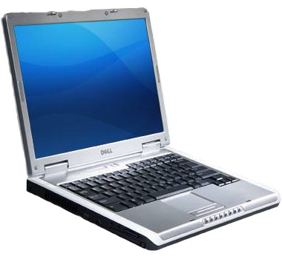
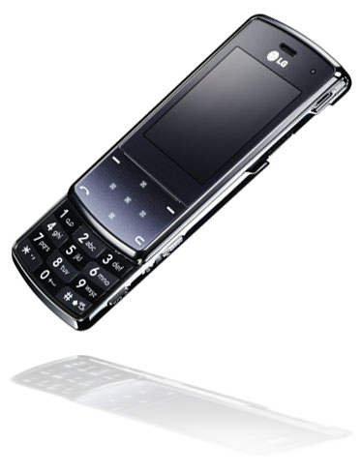
Primary Cells
Dry and wet cells
The chemical reaction cannot be reversed
Secondary Cells
Chemical reactions can be reversed
Also known as rechargeable cells
The reversed flow of electrons restores the reactants that are used up.
Used to start cars, in laptops, cell phones
Can still wear out with time.

Slide 9
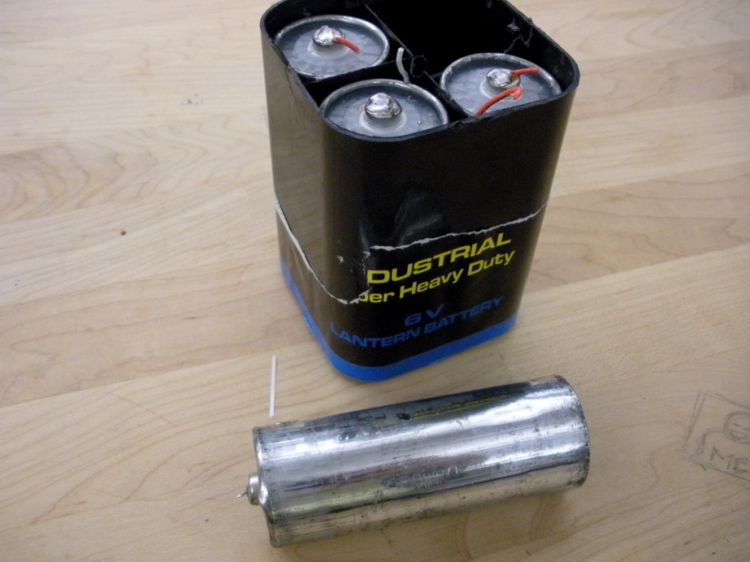
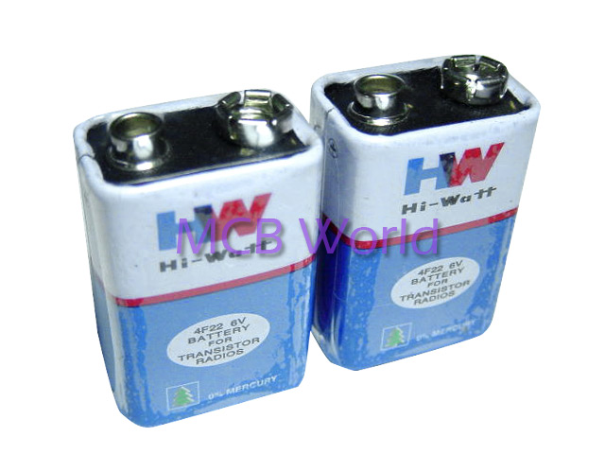
Batteries
Battery – cells connected together
Most are sealed into a case with only two terminals, so you can’t tell that it contains more than one cell

Slide 10
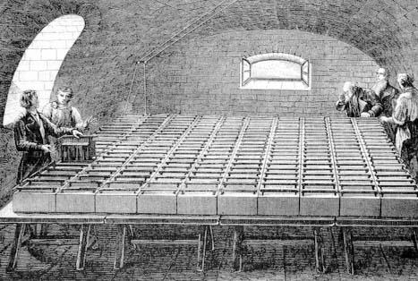
Electrochemistry
Electrochemistry is the study of chemical reactions involving electricity.
Alessandro Volta made the first practical battery around 1800. He used copper and zinc discs separated by electrolyte soaked discs.
In 1807, Humphry Davy connected 2000 cells together in a room to make one massive battery

Slide 11
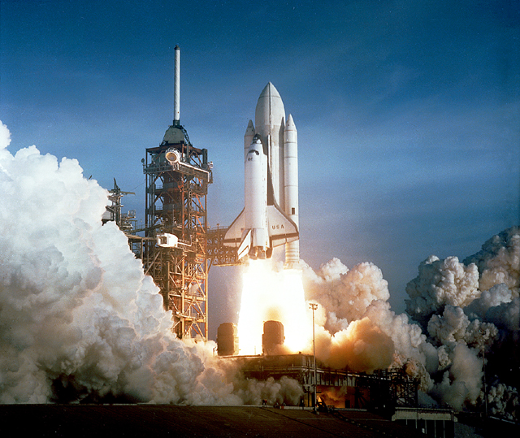
Electrolysis
Splitting molecules into their elements
For example: H₂O split into H₂ and O
Davy’s battery was so powerful it separated pure metals out of compounds.
He discovered potassium, sodium and other elements this way.
Electrolysis of water is used to fuel a space shuttle.
Water is separated into pure oxygen and hydrogen, and when they are mixed together and ignited, it releases a huge amount of energy.

Slide 12
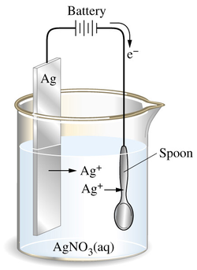
Electroplating
Gold and silver are very popular but also very expensive
Because of this, less expensive products can be coated with a thin layer of silver or gold – called electroplating
Cheap metal is also usually stronger than silver and gold.

