Slide 1
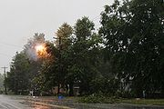
Section 1.3 Electrical Safety
Short Circuit – an accidental low-resistance connection between two points in a circuit, often causing excess current flow.
- current travels along a different path than originally intended.
Short circuits may cause: circuit damage, overheating, fire or explosion.
In electrical devices, unintentional short circuits are usually caused when a wire's insulation breaks down, or when another conducting material is introduced, allowing charge to flow along a different path than the one intended.
Tree limbs cause a short circuit during a storm

Slide 2
Electrical Shock
When wondering how dangerous a current flowing through your body may be, you have to consider 2 aspects of electricity:
Voltage
Amperage
High voltage is more dangerous than low voltage
Number of Amps is more important when assess for potential danger. Too much electricity flowing through a persons body can cause burns, damage to the heart, and can be fatal. Current as low as 0.1 A can be fatal.

Slide 3
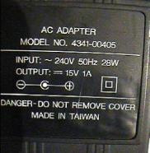
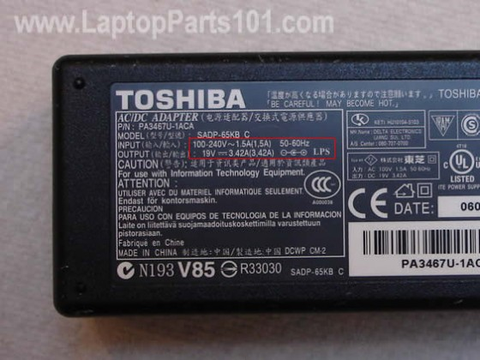
Electrical Shock Con’t
The danger of electrical shock varies, depending on the situation.
Insulator – current does not flow through easily. Such as wood, rubber, and air
Every plug-in device sold in Canada must have a label listing what voltage it requires and the maximum current it uses.
Why would the Canadian government make this a regulation? ________________________________________________
The Amp rating does not have to be high for you to get a shock. If there is a short circuit, or if the insulation is damaged, you can get a shock before the electricity goes though the device.

Slide 4
Electrical Safety pointers
See page 285
Read together

Slide 5
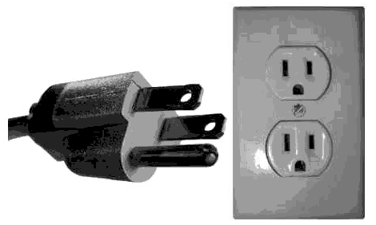
Plugs, Fuses and Breakers
A grounded three-prong plug has an extra wire that connects the device to the ground wire of the building.
Why would we want a plug to have this third prong?
It provides another pathway for the electricity, just incase there is a short circuit.

Slide 6
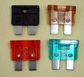
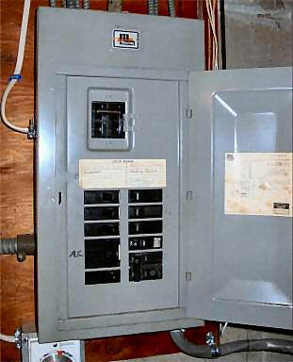
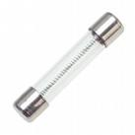
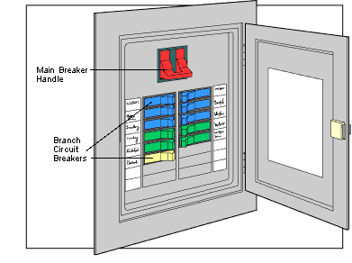
Fuses and circuit breakers interrupt a circuit when too much current is flowing through it.
Fuses have a thin piece of metal that is made to melt if too much current passing through it.
Household breakers also have a special wire that heats up if there is too much current. In a breaker however, instead of melting, the hot wire triggers a spring mechanism to turn off the switch inside the circuit breaker. Once the wire is cooled, the switch can be turned back on.

Slide 7
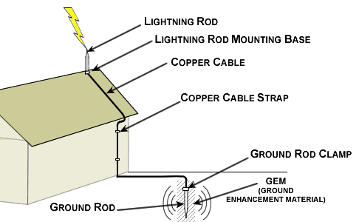
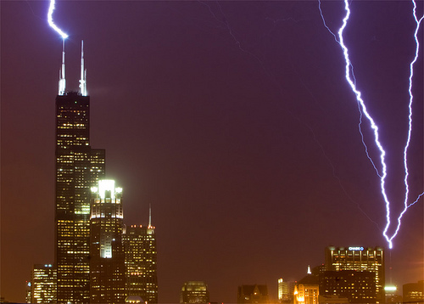
Danger of lightning
Lightning can strike up to 30 000 A, definitely enough to kill a person.
You can survive if: the full current travels through only part or over the surface of your body.
Tall buildings are a natural target for strikes. Why?
Therefore they have lightning rods that are connected to the ground with a wire. This shifts the electrical discharge away from the building, harmlessly to the ground.

